Slide 1
PROPOSED Adjusted Urban Area Boundaries
For Transportation Planning
Sarah Kepchar,
VTrans, Highway Research January 16, 2014

Slide 2
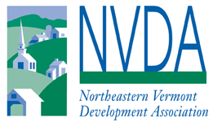
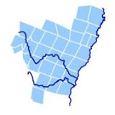
Notes:
Don’t shoot the messenger!

Slide 3
Why Adjust Census Boundaries
The Census Bureau’s urban areas represent densely developed territory, and encompass residential, commercial and other nonresidential urban land uses
Developed based on Census formulas
Population counts,
Residential population density, and
Nonresidential urban land uses such as commercial, industrial, transportation and open space that are part of the urban landscape
Census Bureau designates urban areas after each Decennial Census
Federal Highway Administration then gives the States the opportunity to revise urban area boundaries for transportation planning purposes
Revisions are not required

Slide 4
Guidance from fhwa
Use Census Urban Areas where population >= 5,000 in 2010
Urban Clusters where population >= 5,000
Urbanized Areas
Start with the Census-defined geospatial boundaries of qualifying urban areas after factoring in 2010 Census data
ONE official requirement: “An adjusted boundary includes the original urban area boundary defined by the Census Bureau in its entirety.”
Adjustments may only expand the Census urban boundary
Collaborative effort between State DOT (VTrans) and local planning partners (RPC)
Urban boundaries you see presented today are the very beginning of the conversation
Notes:
Need to start somewhere

Slide 5
2010 Population
Urban Area | Population (2010)
Barre-Montpelier Urban Cluster | 21,675
Bennington Urban Cluster | 12,723
Brattleboro Urban Cluster | 9,971
Burlington Urbanized Area* | 108,740
Middlebury Urban Cluster | 5,350
Rutland Urban Cluster | 19,840
St. Albans Urban Cluster | 9,054
St. Johnsbury Urban Cluster | 5,073
White River Junction (Lebanon-Hanover, NH-VT Urban Cluster) | 6,287
*Milton (8,521 people) is considered an independent urban cluster, however it is merged with Burlington for transportation planning purposes
Notes:
Is WRJ the right name for this urban area? Do we want to call it something else?

Slide 6
What do we already know?
Must use the Urban Cluster and Urbanized Area populations to determine urban area status
Adjusted boundary does not reflect the population of the adjusted area – cannot expand a boundary to add more population.
Newport Urban Cluster does not meet the population threshold (4,004 people) in 2010
White River Junction does meet the population threshold (6,287 people in VT) independently of the Lebanon-Hanover, NH-VT Urban Cluster and is therefore a new urban area

Slide 7
Business Rules used in developing proposed new boundaries
FHWA: Census defined urban boundary is the minimum boundary
Not Urban = Rural
If the Census boundary does not match Vermont data (VCGI), then the boundary is shifted to match Vermont data
Municipal boundaries
Roadways
If road is used to define the urban boundary, the road by default is defined as urban

Slide 8
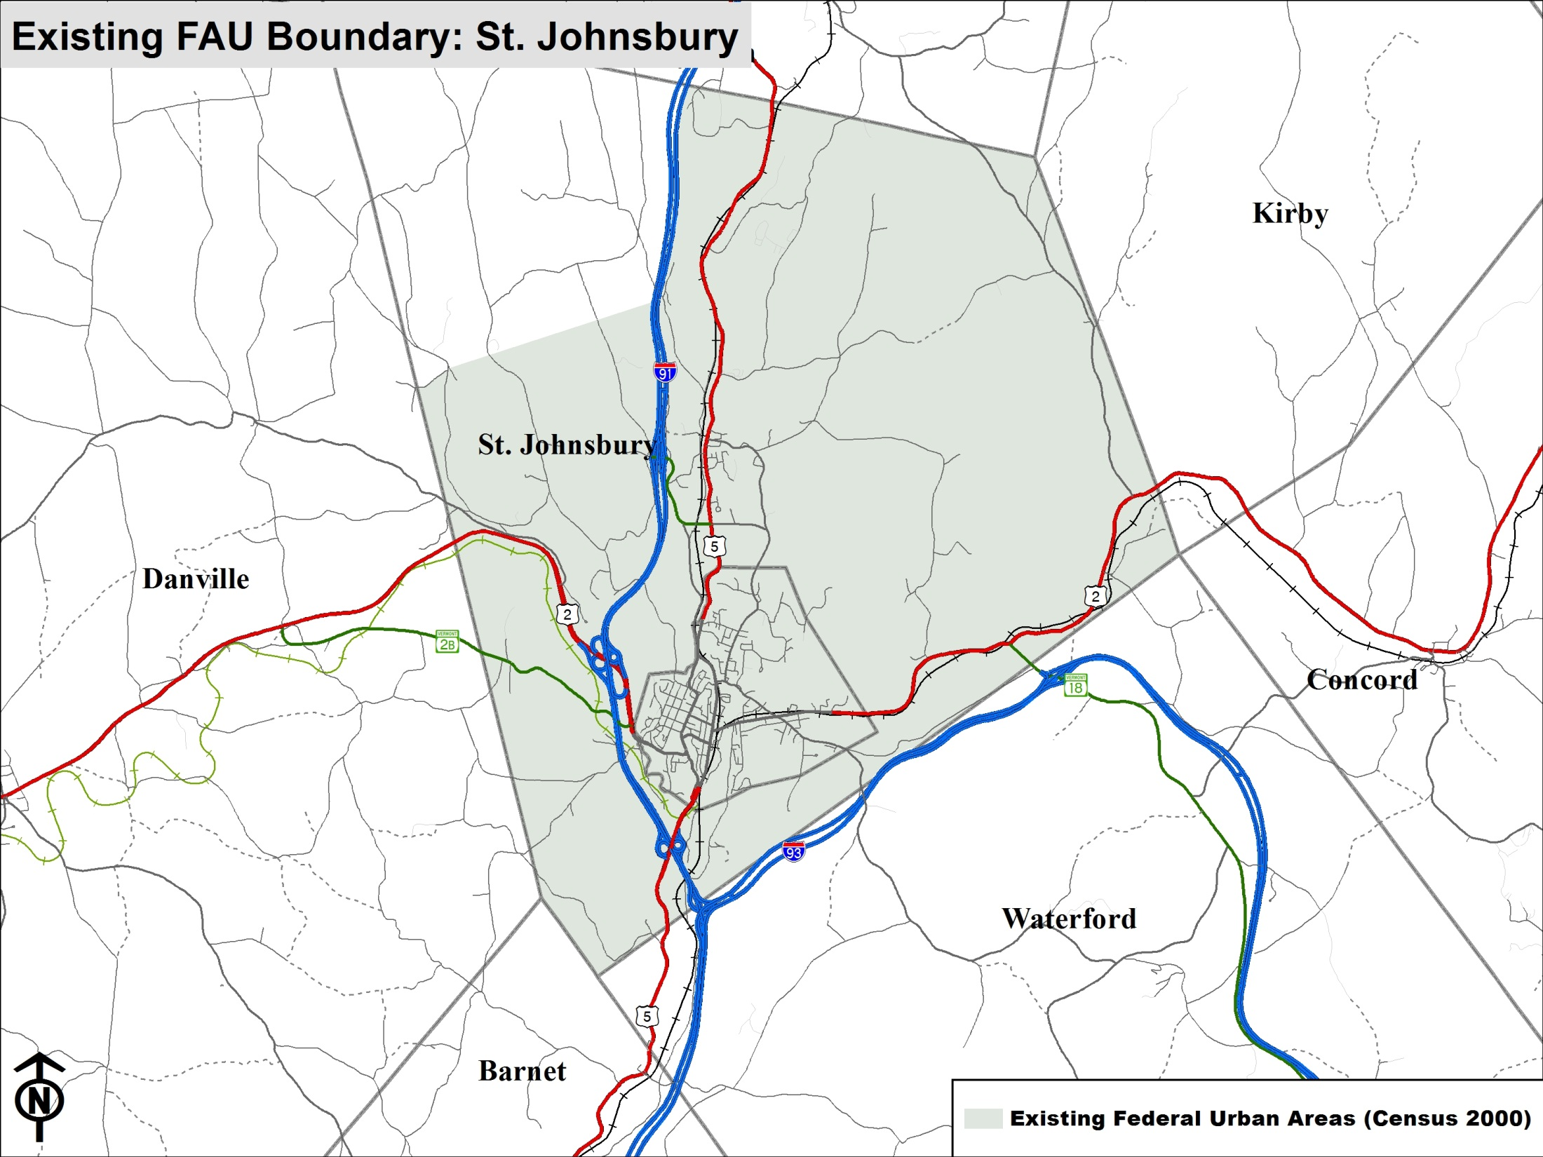
St J Current Boundary

Slide 9
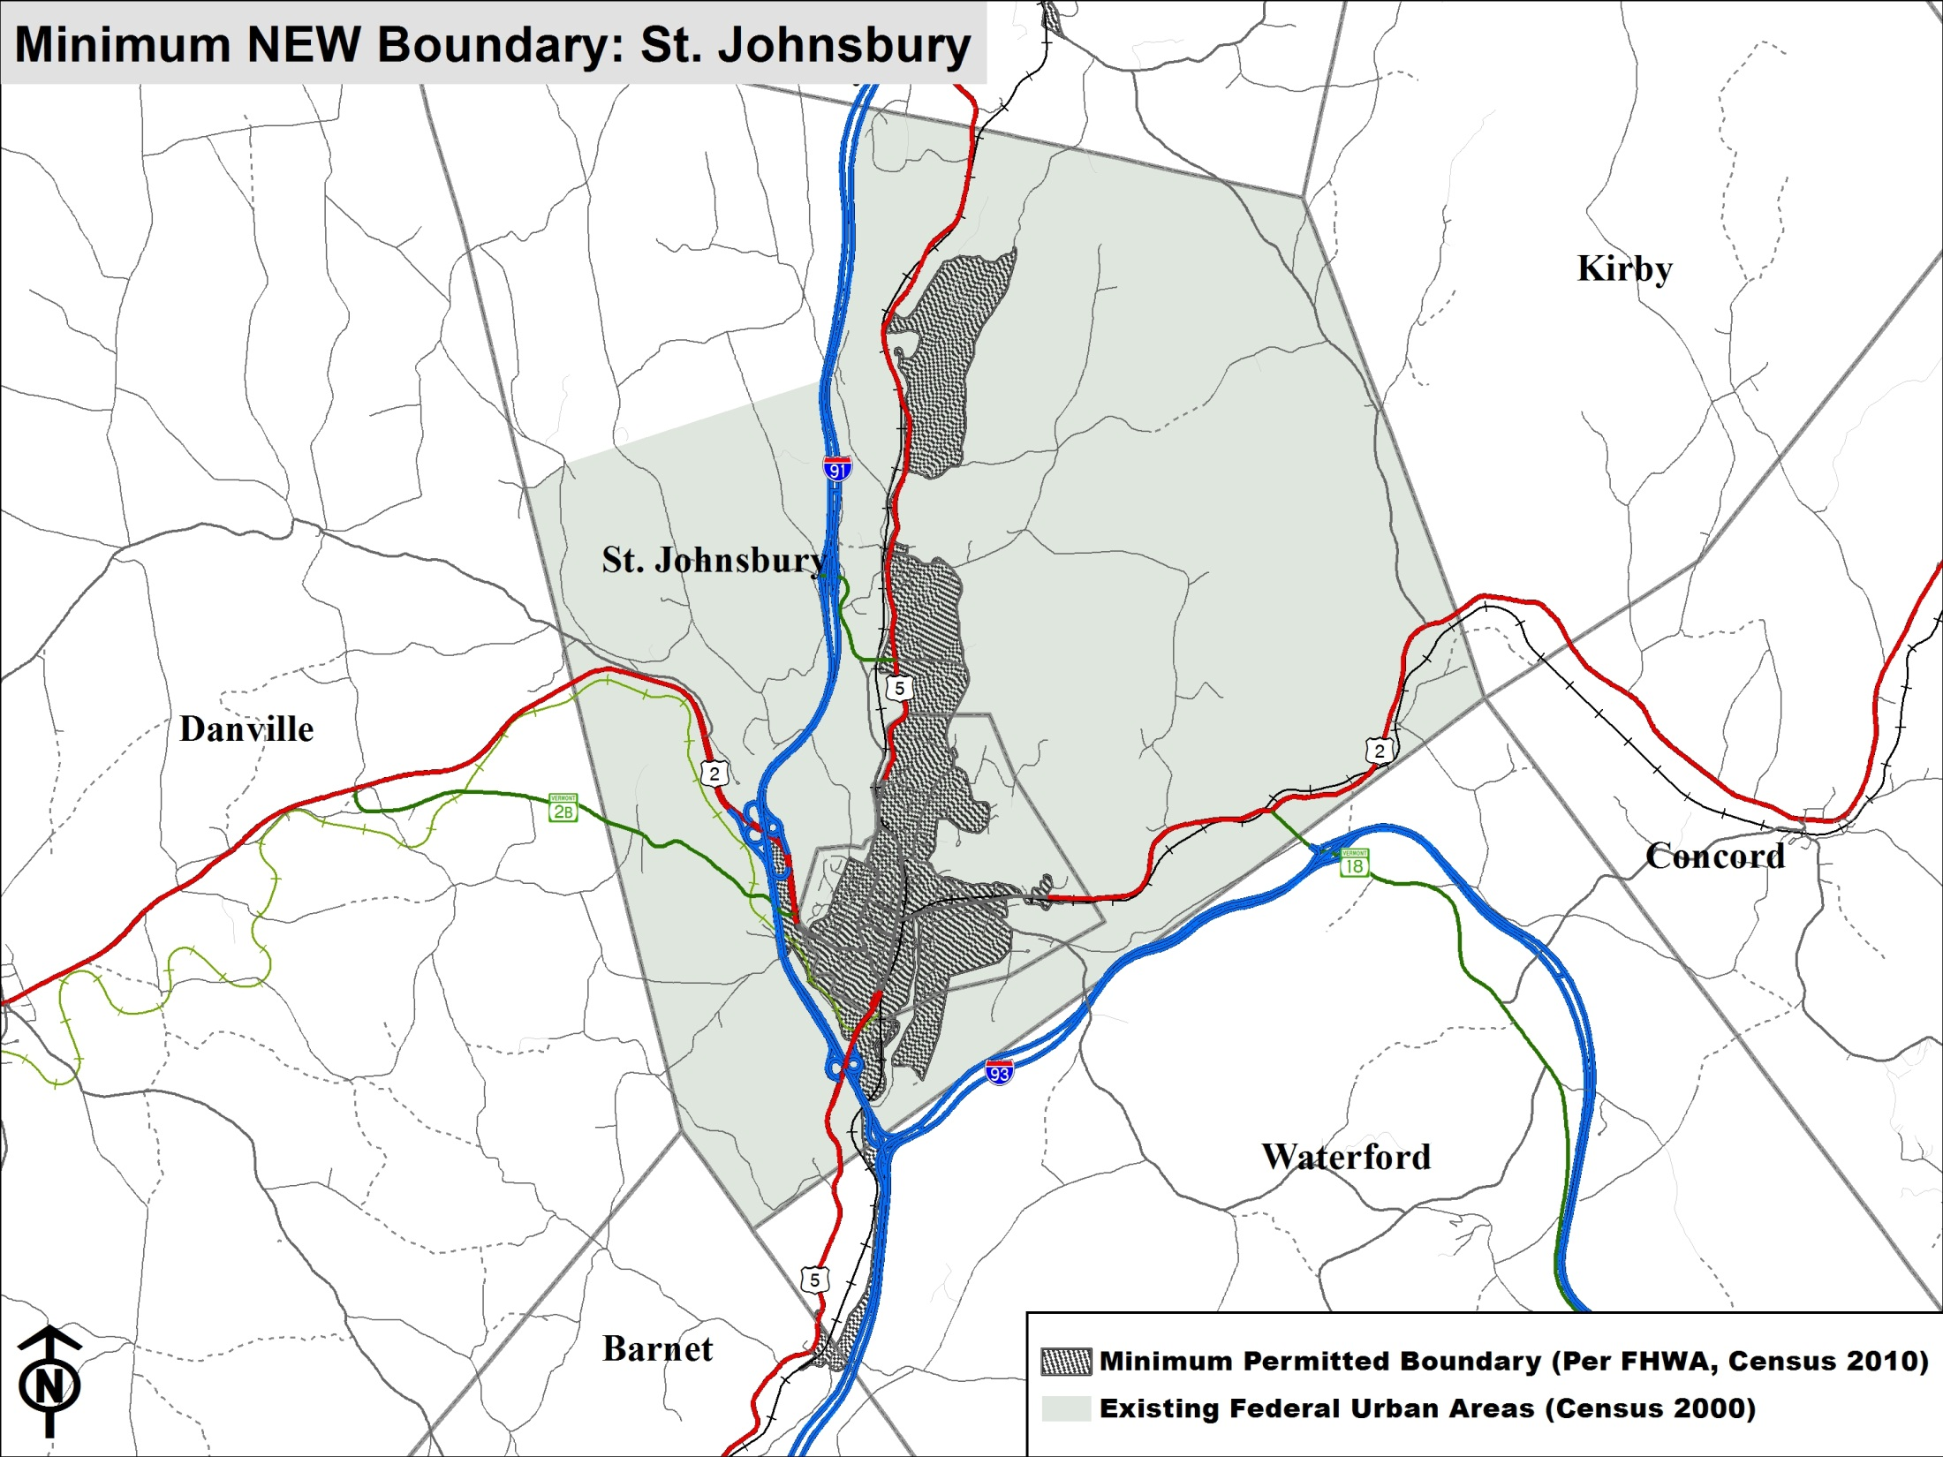
St J Census 2010 Urban plus current boundary

Slide 10
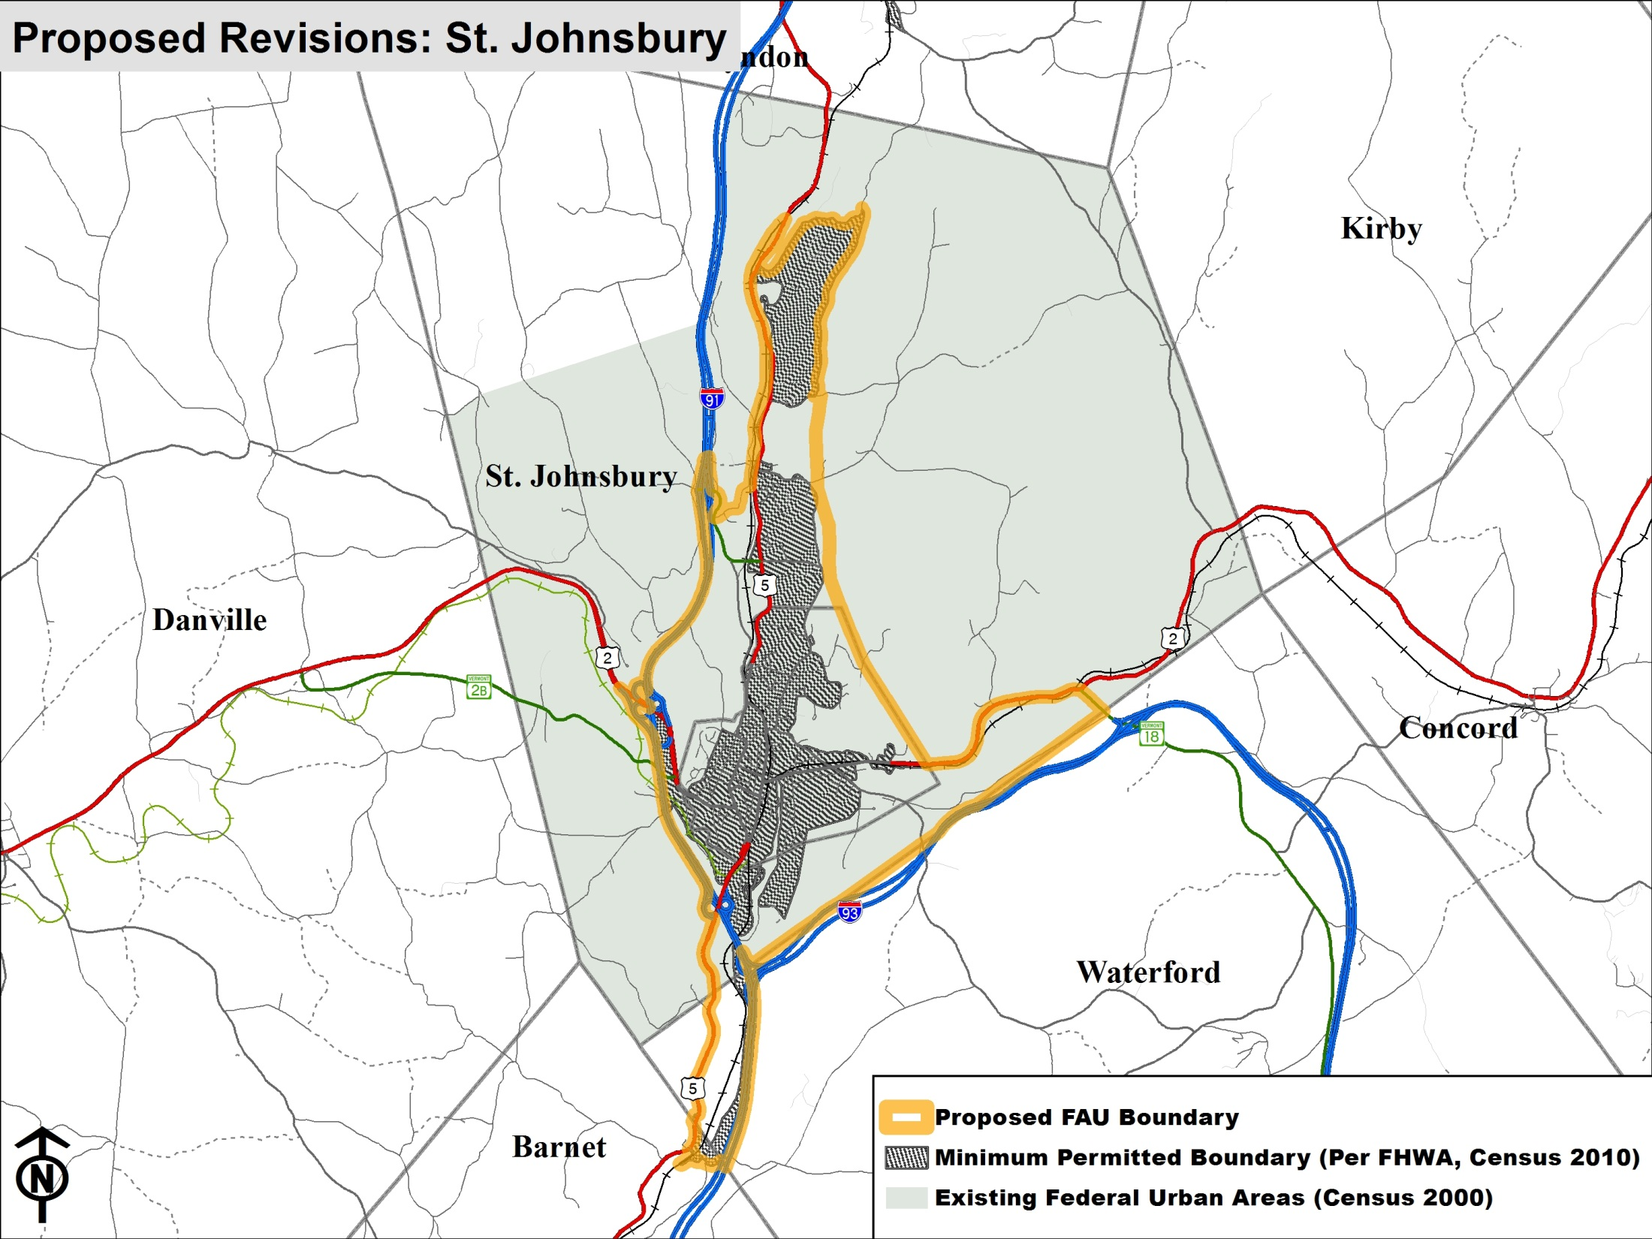
St J proposed boundary on top of current and Census

Slide 11
What’s next
NEXT STEP: Feedback from regions
GOAL: Finalize regional input by February 28
Sarah Kepchar
802-595-9784
sarah.kepchar@state.vt.us
Special Studies Technician
Vermont Agency of Transportation
Policy, Planning and Intermodal Development
Highway Research Section
1 National Life Drive
Montpelier, VT 05633

