Slide 1
2012 Functional Classification Guidelines
Joseph Hausman and Ralph Gillmann
Office of Highway Policy Information
Federal Highway Administration

Slide 2
FHWA Office of Highway Policy Information David Winter, PE
Highway Finance and Recovery Act
Chris Allen
Team Lead
Motor Fuel and Tax Evasion
Ralph Davis
Team Lead
Highway System Performance
Ralph Gillmann
Team Lead
Travel Monitoring and Surveys
Tianjia Tang, PE
Team Lead
Responsible for highway finance data collection (an extensive amount of input on Federal, State, and local governments.
The Recovery Act provides significant new funding for transportation infrastructure.
Analyzes and compiles monthly state data on the amount of gallons taxed by each state.
Provides data to be used in the attribution process
The HPMS is a national program responsible for data on our nation’s highways to the extent of the condition, performance , use and operating characteristics.
Responsible for maintaining national programs to track traffic trends, vehicle distributions, and weight to meet data needs specified in federal highway legislation.

Slide 3
Functional Classification Guidelines
Dates to the 1960’s and 1970’s
Last released in 1989
Virtually unchanged from 1979
Addendum in 1991
More flexibility for classifying routes that cross urban boundaries
Specific criteria for including future or proposed routes

Slide 4
Interim FHWA Guidance
FHWA Memorandum October 2008
Prompted by HPMS Reassessment
Uncoupled functional classification from urban boundaries
Same classes for rural and urban roads
Known as class normalization
Specified research in several topics

Slide 5
2011-12 Research Project
Update existing guidelines
Account for current practices
Incorporate geographic information systems
Improve functional class assignments
Improve consistency between States
Improve the process for States and MPOs
Provide guidance on adjusting urban boundaries

Slide 6
Seven Functional Classes
Arterial
Principal Arterial – Interstate
Principal Arterial – Other Freeways & Expressways (OF&E)
Principal Arterial – Other (OPA)
Minor Arterial
Collector
Major Collector
Minor Collector
Local

Slide 7
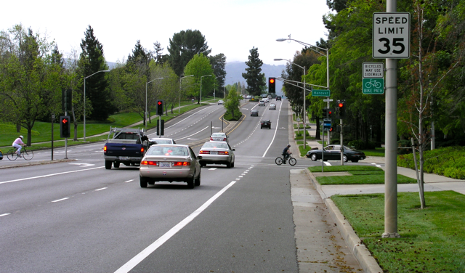
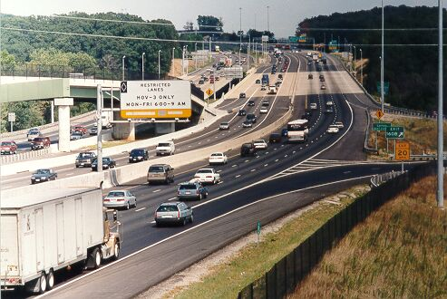
Guidance Highlights
Highway classification defined by function
Real world examples and good practices
Importance of partnerships
“Rule of Thumb” recommendations on VMT and mileage distributions
Applications of functional classification
Other Principal Arterial in California
HOV lane on Interstate 95 in Woodbridge, VA

Slide 8
Adjusted Urban Boundaries
Census Bureau defines Urbanized Areas (UZAs) and Urban Clusters
Title 23 includes Urban Clusters > 5,000
States may adjust the Census boundaries
May combine urban clusters and UZAs
Relation to functional classification
New urban boundaries trigger a review

Slide 9
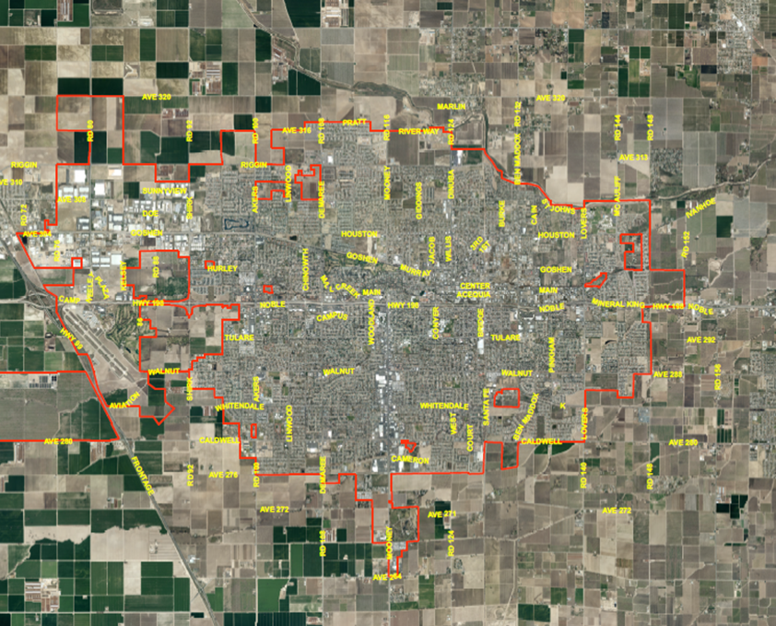
Urban Area Boundaries – Reasons to Expand
Include entire municipality
Include areas with urban characteristics
Include significant generators, e.g., industrial areas, airports
Should be one contiguous area

Slide 10
Functional Class & Urban Boundaries
Urban boundaries define area type
Rural vs. urban has many uses
Combine area type and functional class
Rural Interstate means Interstate in rural areas
Urban collectors
Major collectors & minor collectors in urban areas

Slide 11
Mileage by Functional Class
2011 Mileage | Rural | Urban | Total
Interstate | 30,256 | 16,944 | 47,242
Other Freeways and Expressways | 4,224 | 11,547 | 15,771
Other Principal Arterial | 91,280 | 65,382 | 156,704
Minor Arterial | 135,650 | 108,301 | 244,182
Major Collector | 420,136 | 115,701 | 536,080
Minor Collector | 263,053 | 3,304 | 266,602
Local | 2,037,783 | 787,783 | 2,827,866
TOTAL | 2,982,383 | 1,108,960 | 4,094,447

Slide 12
Mileage by Functional Class
2011 Mileage | Rural | Urban | Total
Interstate | 30,256 | 16,944 | 47,242
Other Freeways and Expressways | 4,224 | 11,547 | 15,771
Other Principal Arterial | 91,280 | 65,382 | 156,704
Minor Arterial | 135,650 | 108,301 | 244,182
Major Collector | 420,136 | 115,701 | 536,080
Minor Collector | 263,053 | 3,304 | 266,602
Local | 2,037,783 | 787,783 | 2,827,866
TOTAL | 2,982,383 | 1,108,960 | 4,094,447

Slide 13
2012 Guidelines Document
Research project results
State and MPO input
Reviewed
FHWA Technical Review Committee
State and MPO practitioners
OMB Good guidance review
Ready to be released and posted online

Slide 14
Questions and Comments
Joseph Hausman
Office of Highway Policy Information
Federal Highway Administration
202-366-5047
Joseph.hausman@dot.gov

