Slide 1
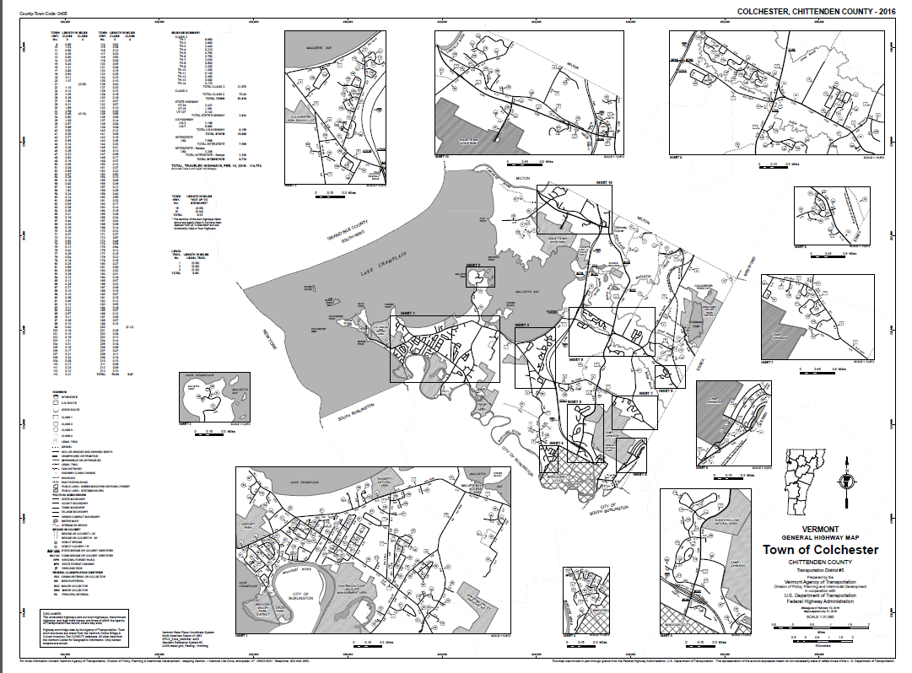

Mapping Systems & Data Overview
Vermont Agency of Transportation
Mapping Section
September 2023

Slide 2
Mapping Systems and Data Overview
5 minutes – Introduction to Mapping
5 minutes – Overview of the Road Centerline data
10 minutes – Town Highway Maps and Highway Mapping System
10 minutes – Linear Reference System (ETE, TWN and ARNOLD) Generation
10 minutes – Route Log System
10 minutes – Event Tables and Management
10 minutes – Discussion and any additional items
https://vtrans.vermont.gov/planning/maps/mileage-certificates
http://vtrans.vermont.gov/planning/maps/publications
2

Slide 3
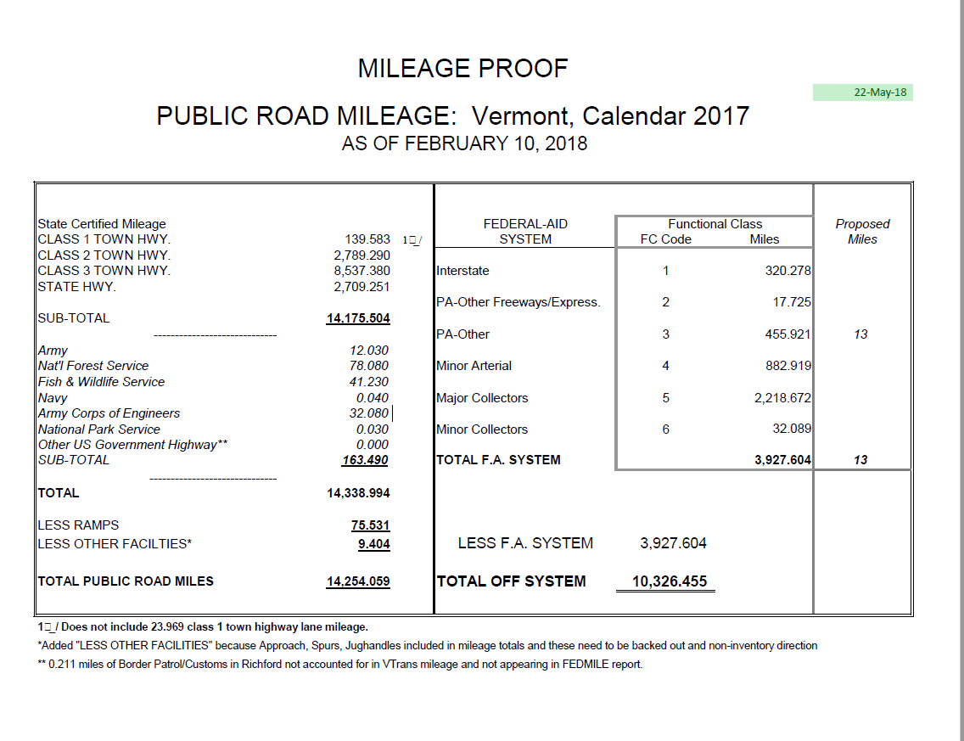
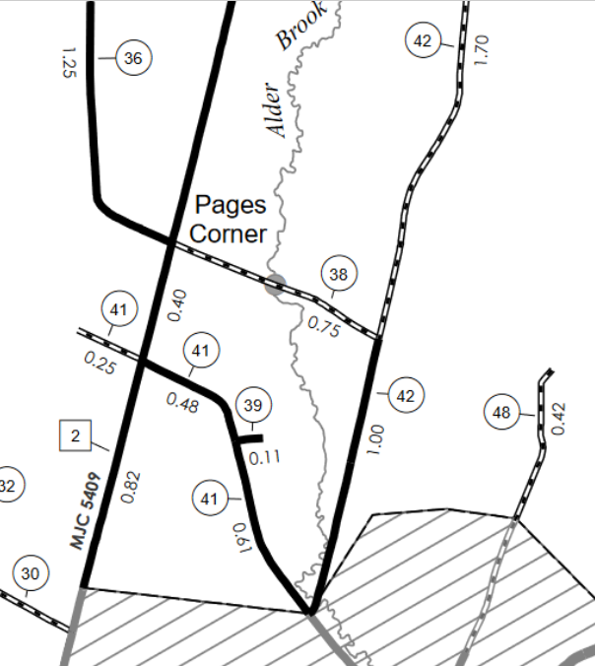
Mapping Section Overview
Mapping Section Staff:
  Johnathan Croft
  Michael Trunzo
  Kerry Alley
  James Blouin
  Pam DeAndrea
Core Tasks:
  Mileage Certificates
  Annual Mileage Summary
  Certified Public Highway Mileage
  Town Highway Maps
  Route Logs
  Linear Reference System
  Functional Class & NHS highways
  Federal Aid Urban Areas
  MIRE
  Intersections
VTrans Mapping Section Overview
3

Slide 4
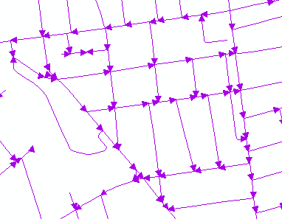
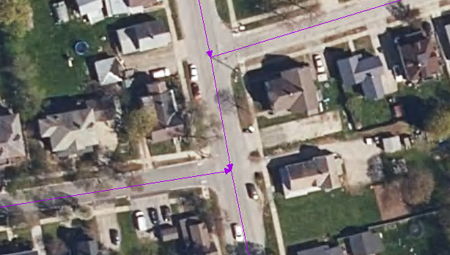
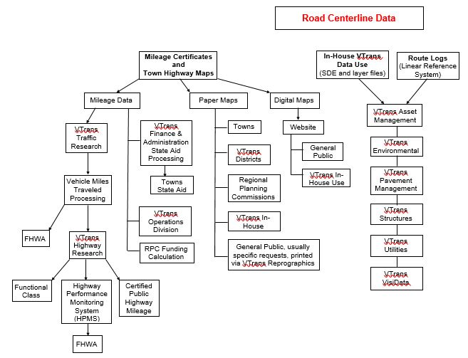
Master Road Centerline - RDSMALL
The master road centerline data layer – RDSMALL is the core dataset used to manage classified highway mileage, generate the linear reference system, produce the Town Highway Maps, meet MIRE requirements, foundation for intersections, many downstream products.
Single seamless statewide dataset
Managed in ArcSDE – SQL Server
Multi-user versioned GDB
VTrans Road Centerline Data
Road Centerline User Guide
4
Notes:
A new solution was needed. One that could handle multiple insets, and different mileage reports. It also needed to accommodate different map sizes and layouts. We also wanted to eliminate the annual rebuilding of the MXD’s
Johnathan will now explain the solution

Slide 5
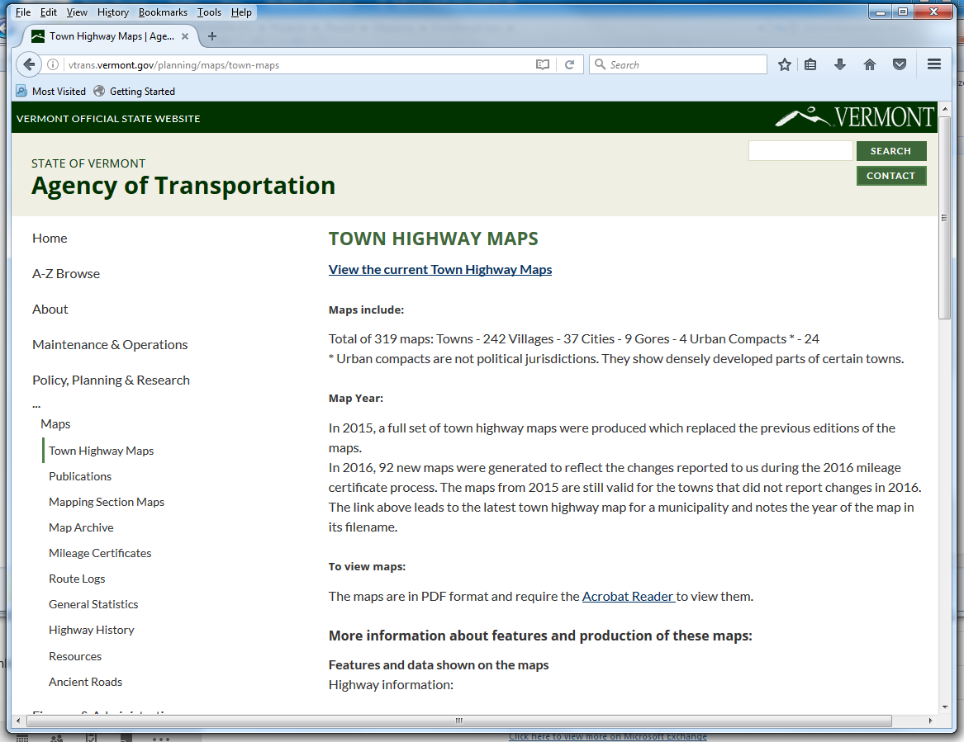
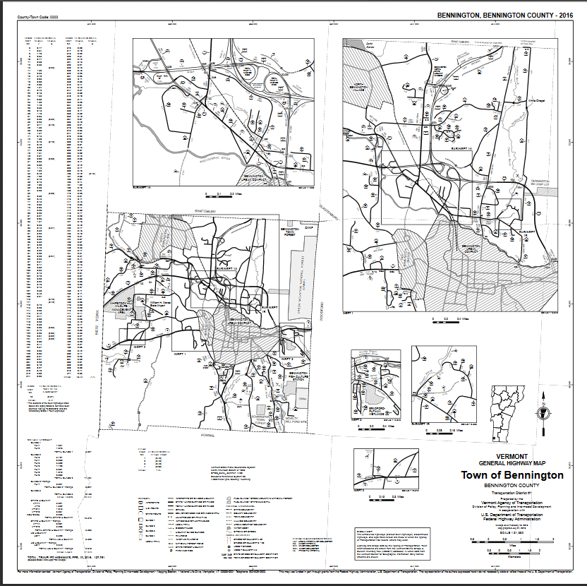
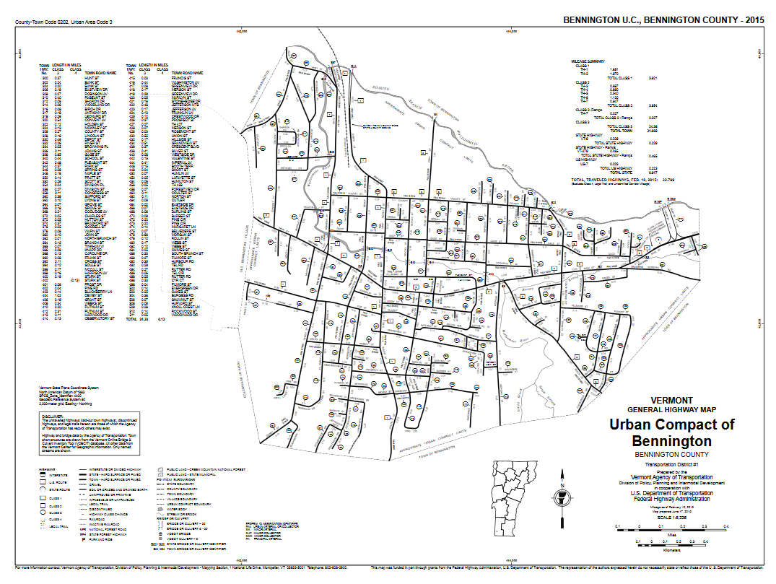
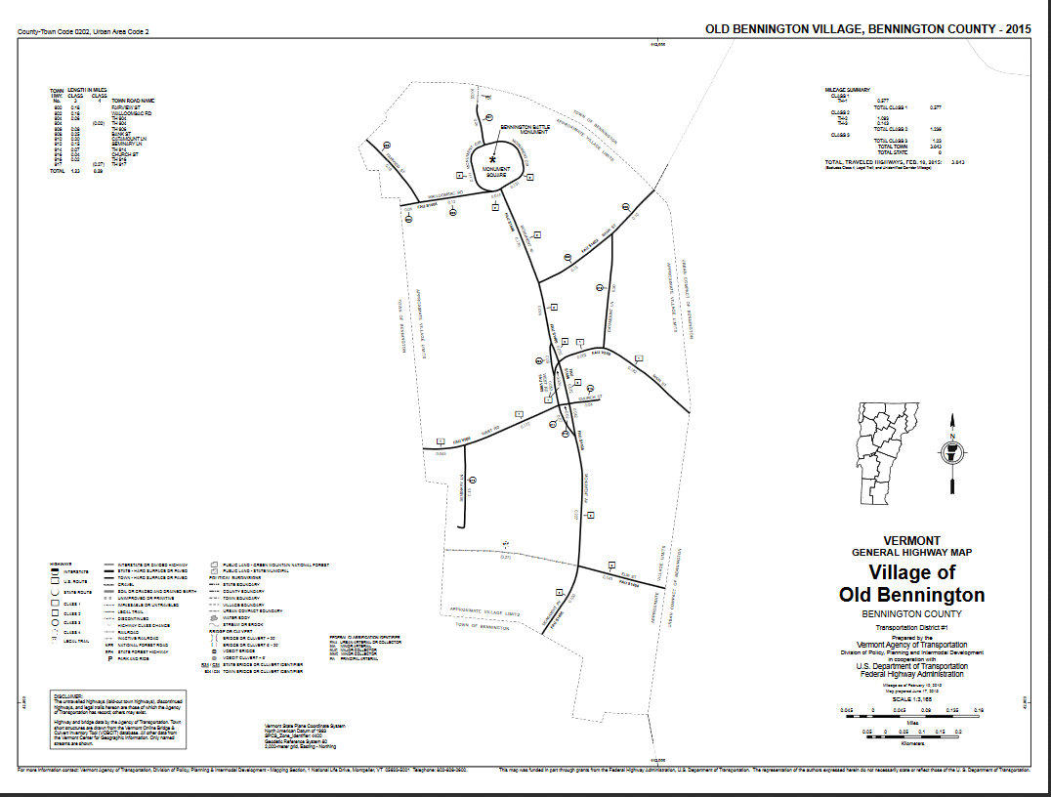
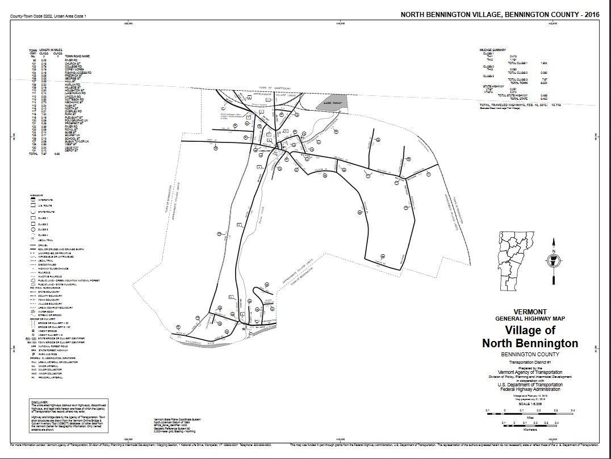
Town Highway Maps & HMS
The Mapping Section produces 319 individual Town Highway Maps of each municipality in Vermont.
https://vtrans.vermont.gov/planning/maps/town-maps
5

Slide 6
Linear Reference System
TWN – Town-Based LRM
ETE – End-To-End LRM
ARNOLD – All Roads
Master Route Definition Table
VTrans Linear Reference System (LRS) is created every 6 months through a scripted process using the road centerlines and calibration points for the federal aid system highways. 2 linear reference methods are created, the town-based (TWN) that is based on routes that re-zero at town boundaries and the end-to-end (ETE) that is are cumulative routes. The All Roads Network of Linear-referenced Data (ARNOLD) is generated once a year by fusing the ETE LRM and the local roads LRM that is generated through an automated process.
Linear Reference System and Linear Reference Methods Data Dictionary
Linear Reference System Feature Service
ARNOLD Feature Service
6

Slide 7
Route Logs – Straight Line Diagrams
The Section produces approximately 1600 Route Logs, which are straight line diagrams of the federal aid highway system, providing detail on geometrics, projects, AADT, crashes and other pertinent information.
7
https://vtrans.vermont.gov/planning/maps/route-logs

Slide 8
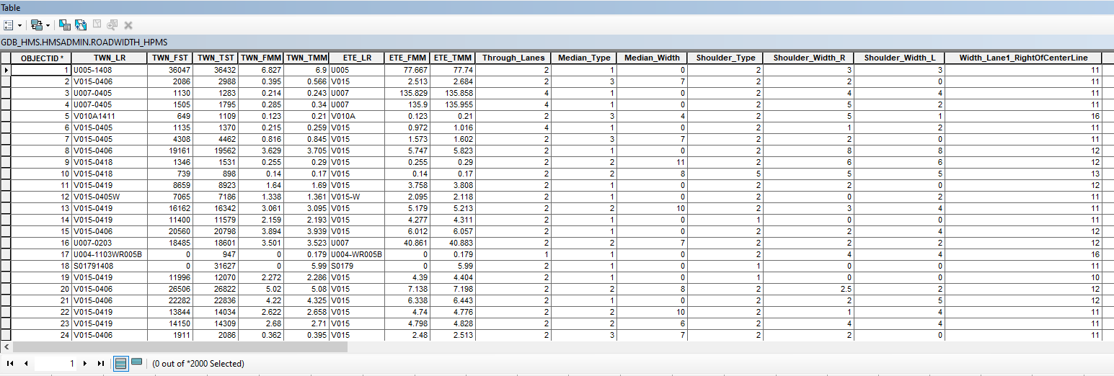
Event Table Management
Road Width
Historic Projects
Functional Class
Limited Access
National Highway System (NHS)
Bicycle Corridor Priority
Customer Level of Service
Curves
Grade
Speed Limits
Events are managed through manual processes at the moment, and some layers go through overnight QA/QC to ensure no overlaps, full coverage of the network, etc.
Significant work goes into LRS measure updates when changes occur.
8

Slide 9
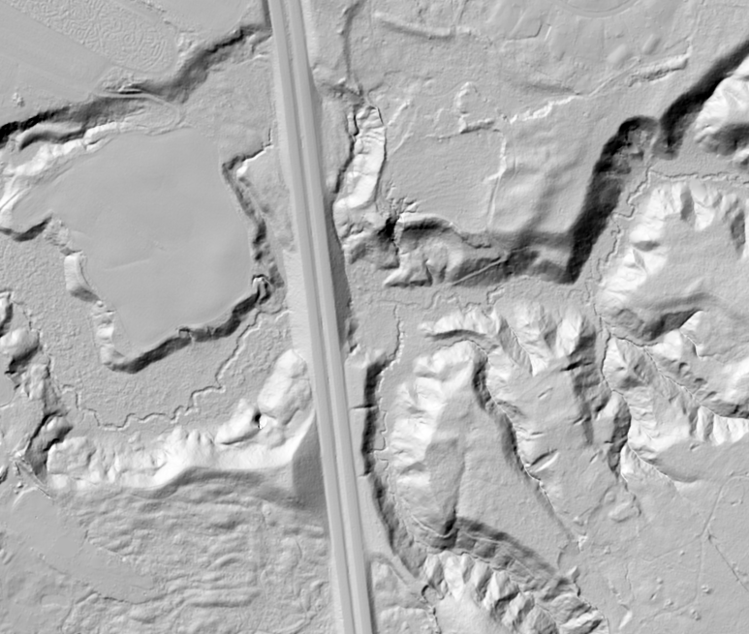
Questions???
Johnathan Croft
Johnathan.Croft@vermont.gov
(802) 828-2600
James Blouin
James.Blouin@vermont.gov
(802) 595-2245
Michael Trunzo
Michael.Trunzo@vermont.gov
(802) 498-8306
Kerry Alley
Kerry.Alley@vermont.gov
(802) 917-2621
Pam DeAndrea
Pam.DeAndrea@vermont.gov
(802) 793-7555
VT Agency of Transportation
Policy, Planning & Intermodal
Development Division -
Mapping Section
More details available on-line at the Mapping Section’s web pages at -
https://vtrans.vermont.gov/planning/maps
9
Notes:
I would be glad to answer any questions regarding our projects and you can also reach out to the full team, listed here for details.
Questions???

