Slide 1
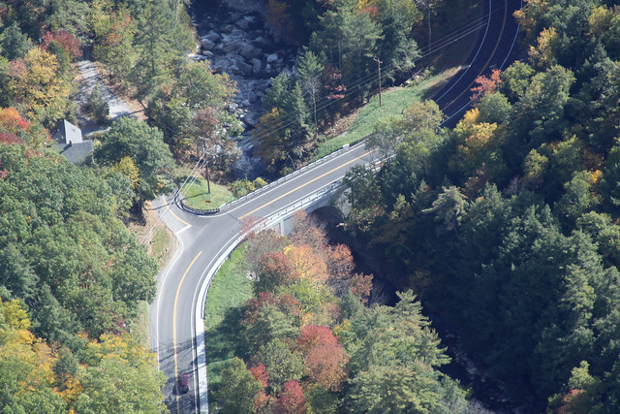
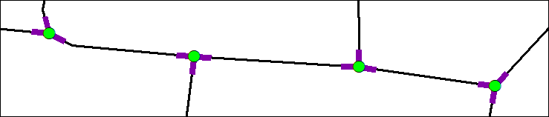

Assembling
Vermont’s
Intersection
Data
Kerry Alley
GIS-T 2019
Notes:
Today I’ll be talking about our new Intersection Data

Slide 2
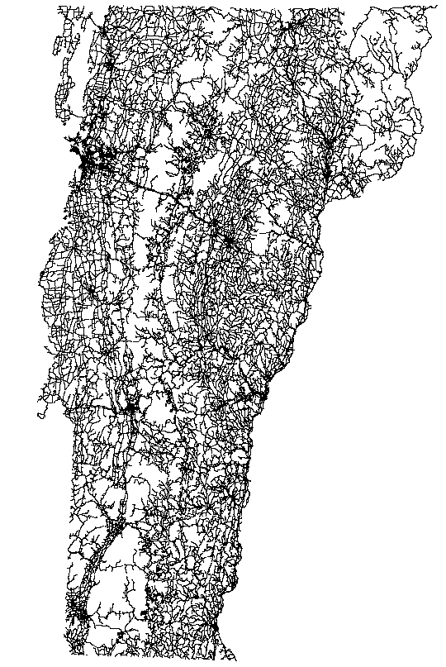
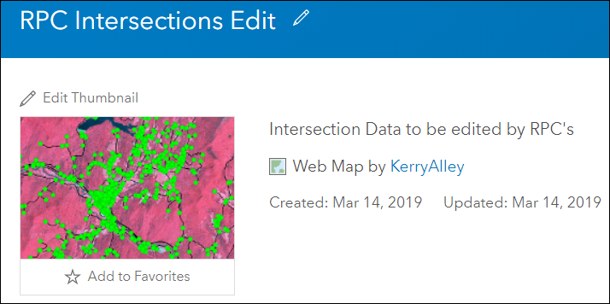
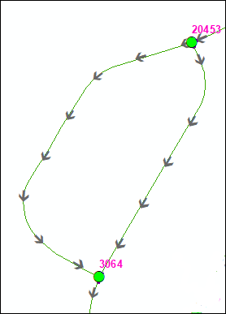
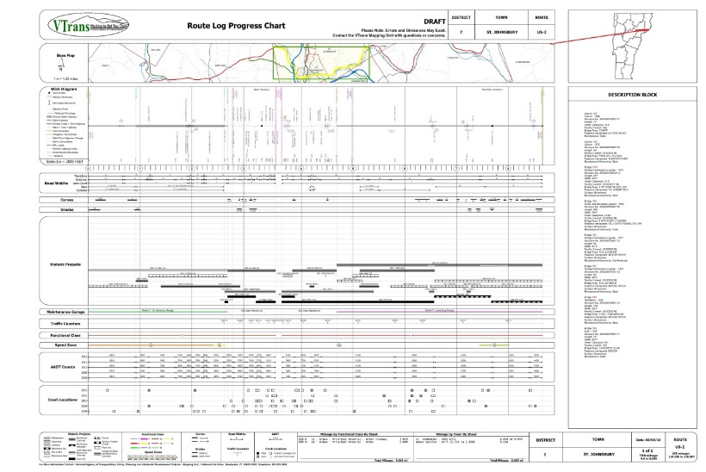


Interconnected Processes
  Data Creation – Maintenance – Use – Evolution
Notes:
Creating the VTrans Intersection Data required consideration of it’s use, maintenance, and potential changes in how intersections are modeled. Maintenance workflows, tools, new uses already exist and the data is not yet complete.

Slide 3
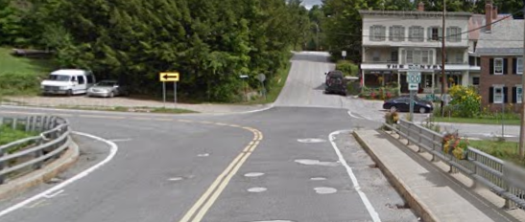
Today’s Presentation
Our objectives/approach to Intersection Data
Internally developed automated processes
    (facilitating data creation
    and maintenance)
Future directions
Notes:
I’ll be focusing on a subset of objectives that I haven’t heard as much about as I hang out with other intersection folks, and ideas that were particularly useful to us.
Farmed out tasks
(not everything can be automated)

Slide 4
VTrans Objectives/Approach
MIRE and Safety Analyst compatible
Extensible and flexible
Requires little change in ongoing data maintenance efforts
Leverages existing data
Facilitates Agency-wide data integration

Slide 5
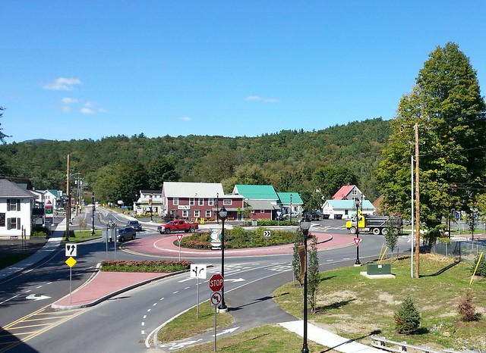
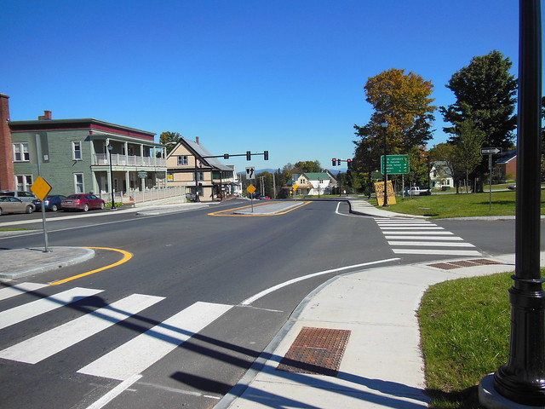
VTrans Objectives/Approach
Intersection data capable of supporting intersection complexity and a generalized representation as needed, depending on use scenario
    Major and Minor Routes AND Individual Legs, Complex geometry

Slide 6
VTrans Objectives/Approach
Intersection data capable of supporting intersection complexity and a generalized representation as needed, depending on use scenario
    Major and Minor Routes OR Legs, Complex geometry
Intersection features “wedded” to Road Centerline
    Approach (Leg) attributes extracted/updated from road centerline attributes
    Relationships between features indicated by
        Intersecting geometry
        Unique IDs shared between related features

Slide 7
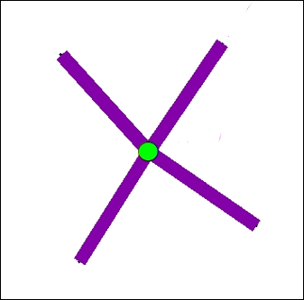
Two Intersection Feature Classes
Nodes
&
NodeLegs
Nodes
    Point features
NodeLegs
    Line features
NodeLeg
Node
Notes:
Before I talk about representing different scales of intersection complexity… Introduce you to our data, as I’ll be referring to these features a lot by name in the coming slides

Slide 8
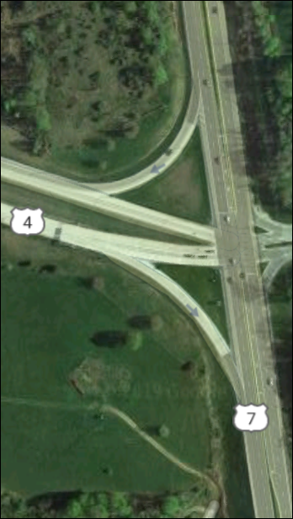
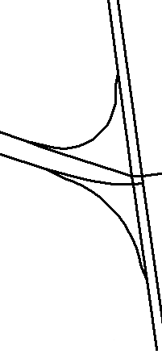
VTrans Objectives/Approach
●
Intersection Complexity
Generalized Intersection

Slide 9
VTrans Objectives/Approach
●
Generalized!
HOW?

Slide 10
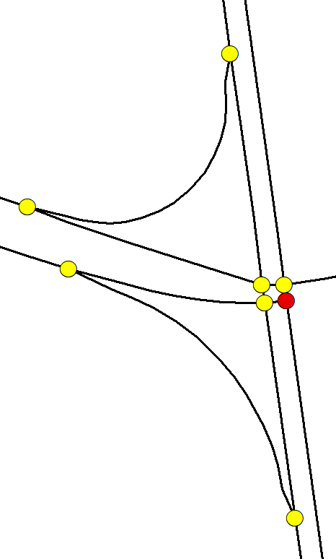
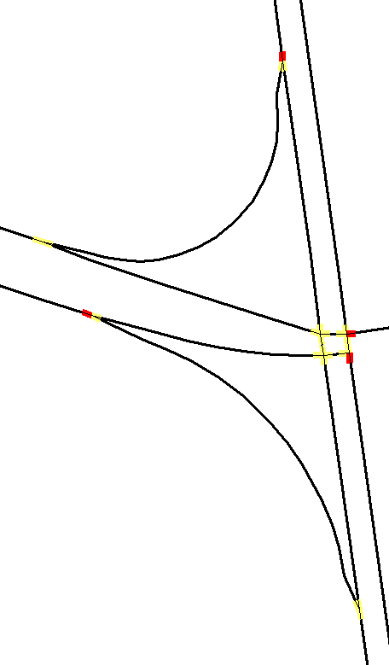
VTrans Objectives/Approach
One Node is the Principal Node
A subset of the NodeLegs are Principal NodeLegs
Complex Intersection
Road Centerline
Nodes
NodeLegs

Slide 11
VTrans Objectives/Approach
One Node is the Principal Node
A subset of the NodeLegs are Principal NodeLegs
NodeLegs

Slide 12
VTrans Objectives/Approach
One Node is the Principal Node
A subset of the NodeLegs are Principal NodeLegs
NodeLegs

Slide 13
VTrans Objectives/Approach
One Node is the Principal Node
A subset of the NodeLegs are Principal NodeLegs

Slide 14
Nodes and Legs → Intersections
Simple Intersections
    Single Node and its Legs
Complex Intersections
    Multiple Nodes and all their Legs
    Generalized to a single Node and one Leg per ‘approach’
Also → Nodes with NodeLegs, but Not Intersections:
    Dangles (one Leg, dead ends)
    Pseudonodes (two Legs, split polyline)
    Not-at-grade Nodes
    Transitions between single and dual carriageways
Notes:
Easier to maintain ALL Nodes and NodeLegs than some.
Attributions clarifies which Nodes belong to intersections, and which represent complex intersections

Slide 15
Safety Analyst’s Perspective
    Published “Safety Performance Functions” (SPFs) are based on safety statistics and real intersections
    Safety Analyst assumes intersection attributes are consistent with assumptions underlying each SPF
    Intersection Geometry and Stop Control assumed to be consistent with definitions of Major and Minor routes
    Major Route – Thru-route with more traffic
    Minor Route – Intersects Major route, has stop control
Notes:
We had to make sure our data would be useful with Safety Analyst (not just compatible)
So a major (no pun intended) task was to understand the assumptions built into the SPFs and definitions of Major and Minor routes.

Slide 16
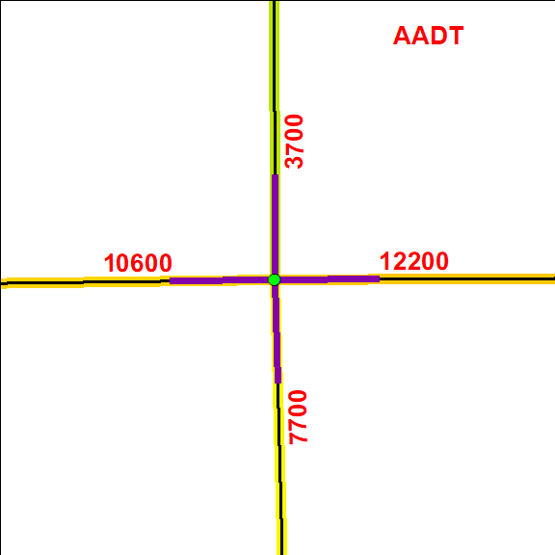
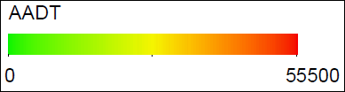
Sort NodeLeg records in order of decreasing AADT!
Notes:
It was easiest for me to develop a method of determining Major and Minor legs by finding patterns when the legs were listed in order of decreasing AATD (In this case ranking the Legs 1-4)

Slide 17
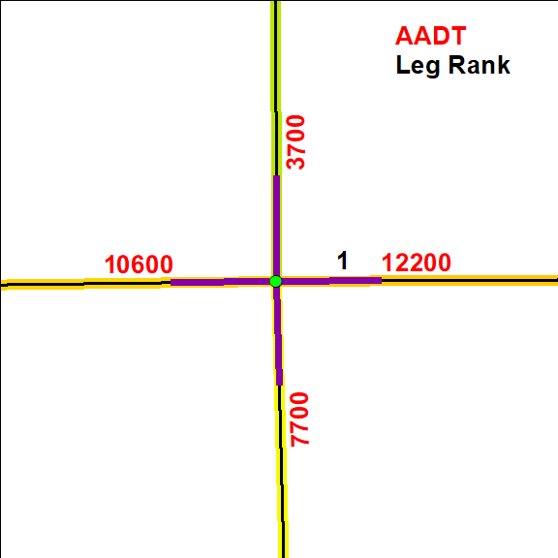

Slide 18
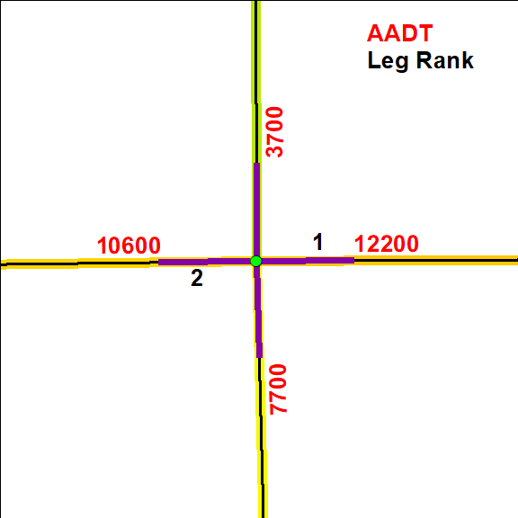

Slide 19
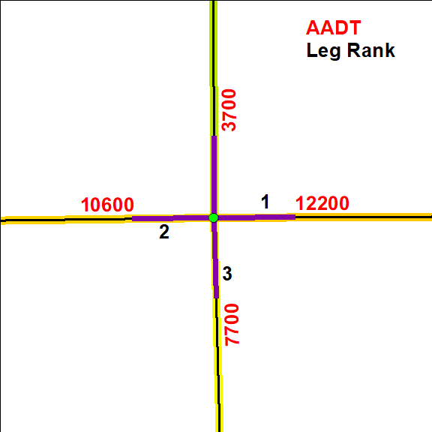

Slide 20
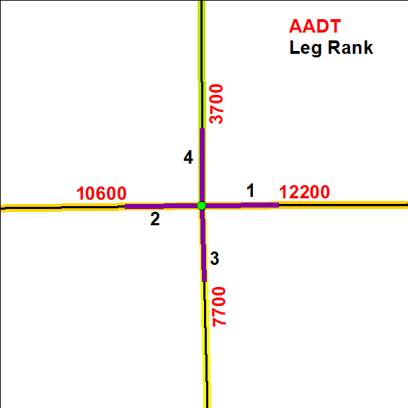
Notes:
Now… how to translate this to Major and Minor?

Slide 21
Leg Rank → Major & Minor?
How does knowing the rank of NodeLegs help us identify an intersection’s Major and Minor routes?
Which NodeLegs provide values for a Node’s attributes for Major and Minor routes?
How do we keep track of this in our data?

Slide 22
Leg Rank → Major & Minor?
Major route attributes – Transferred from a Node’s “Major Leg” (highest AADT)
Minor route attributes – Transferred from a Node’s Leg with highest AADT that intersects the Major route

Slide 23
?
?
?
?
Notes:
Now… how to translate this to Major and Minor?

Slide 24
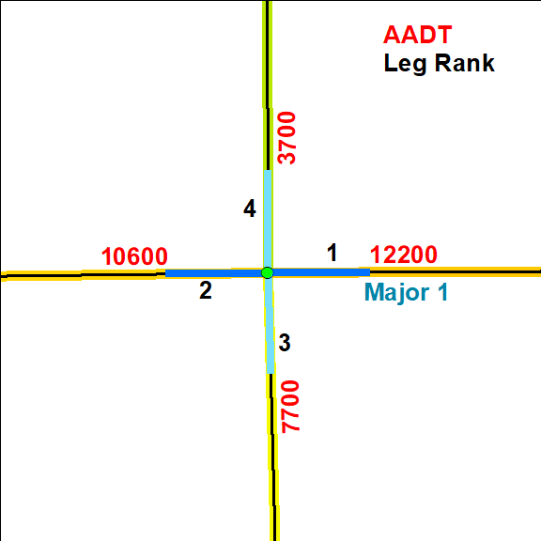
Notes:
Here we have a view of a few intersections in Vermont’s capital city, Montpelier

Slide 25
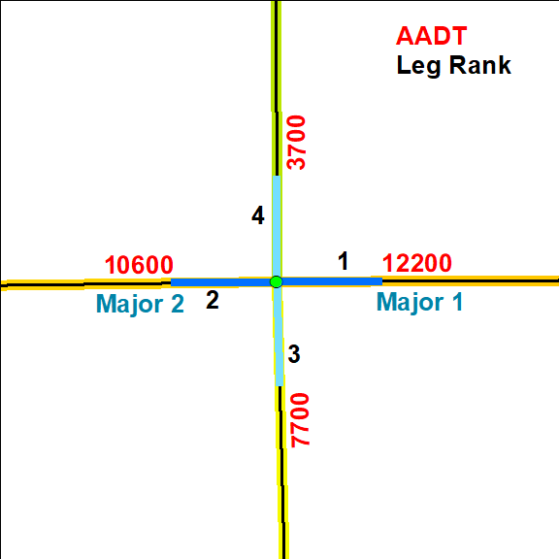
Notes:
Here we have a view of a few intersections in Vermont’s capital city, Montpelier

Slide 26
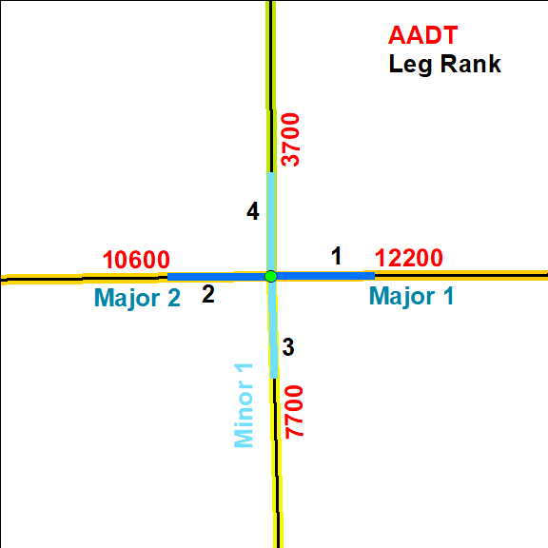
Notes:
Here we have a view of a few intersections in Vermont’s capital city, Montpelier

Slide 27
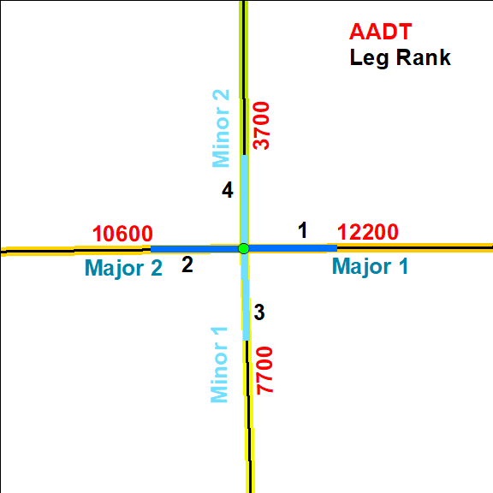
Notes:
Once we know which legs are Major 1, Major 2, Minor 1, and Minor 2

Slide 28
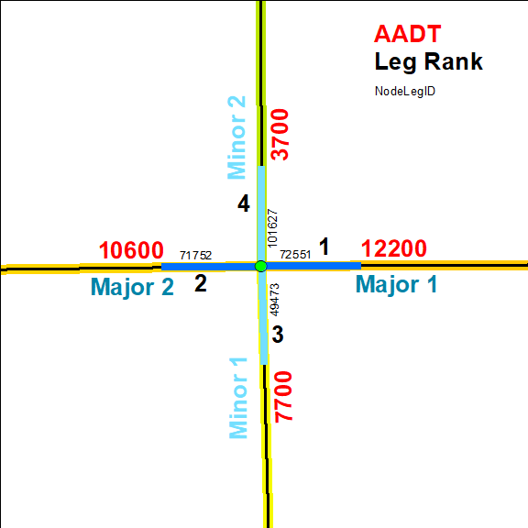
Notes:
These NodeLegs that are ranked 1-4 have UniqueIDs (NodeLegID)

Slide 29
Notes:
Here we have a view of a few intersections in Vermont’s capital city, Montpelier

Slide 30
How To “Automate”?
Major 1 always highest AADT (except some T intersections)
Major 2 always cross-street of Major 1
    Major 2 = Leg 2 if Angle 1-2 ≈ 180°
    Major 2 = Leg 3 if Angle 1-2 ≈ 180°
Minor 1 is intersecting leg with highest AADT
Minor 2 is cross-street of Minor 1
Notes:
Most general consideration

Slide 31
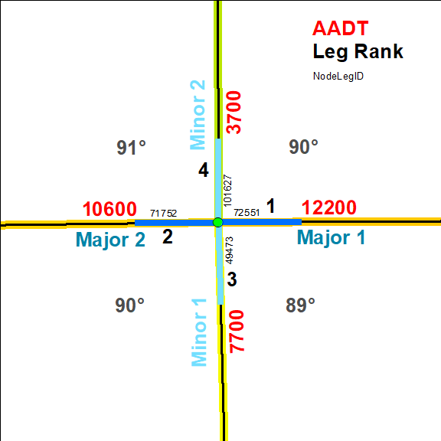
Notes:
Here we have a view of a few intersections in Vermont’s capital city, Montpelier

Slide 32
How To “Automate”?
Query subset of Nodes that will have same relationship between Leg rank and Major/Minor designation
(Angle_1_3 >= 175 AND Angle_1_3 <= 185) AND (Angle_1_2 >= 75 AND Angle_1_2 <= 95) AND AADT_NullCount = 0
(Look at Nodes where all
Legs have AADT values)

Slide 33
How To “Automate”?
Bulk populate Major_1, Major_2, etc. fields indicating Leg rank and corresponding NodeLegID
From previous query, Legs 1-4 (sorted by AADT) are:
    Major_1, Minor_1, Major_2, Minor_2 (respectively)
In other words:
    Major_1, Minor_1, Major_2, Minor_2 are Legs 1, 3, 2, 4

Slide 34
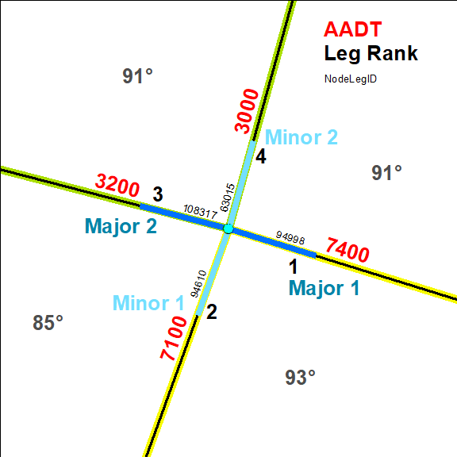
Notes:
Here we have a view of a few intersections in Vermont’s capital city, Montpelier

Slide 35
Notes:
Here we have a view of a few intersections in Vermont’s capital city, Montpelier

Slide 36
ArcMap AddIns
HMS Toolbar
  Node-centric tools – select intersecting Road Centerline arcs and (depending on tool) the Node its NodeLegs
      LegsOnly
      AddAll
      UpdateAll
      UpdateNodeLegCount
  Centerline-centric tools – select any number of Road Centerline arcs
      CheckRelationalAttributes
      CheckRoadwayAttributes
      UpdateRelationalAttributes
      UpdateRoadwayAttributes
Notes:
I have documentation that describes (from an editor’s perspective) the tools and their use

Slide 37
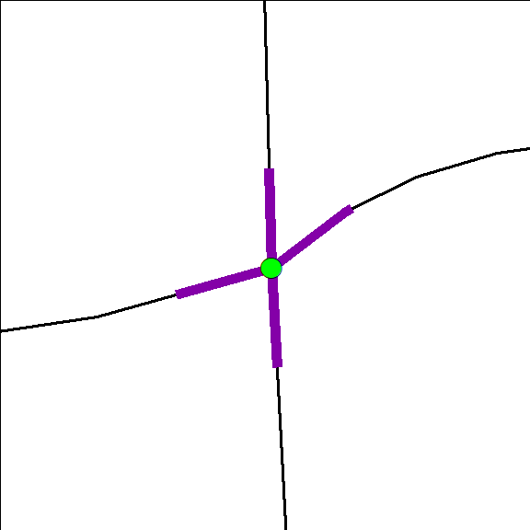
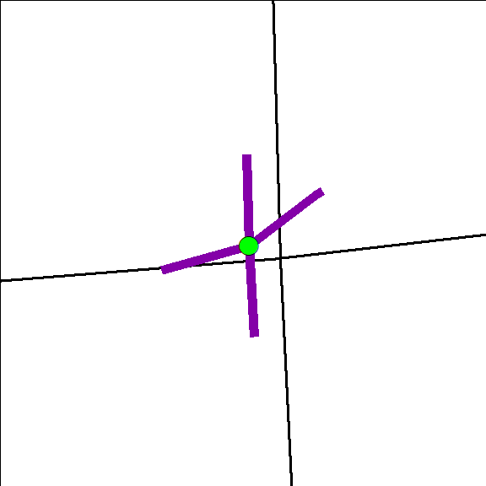
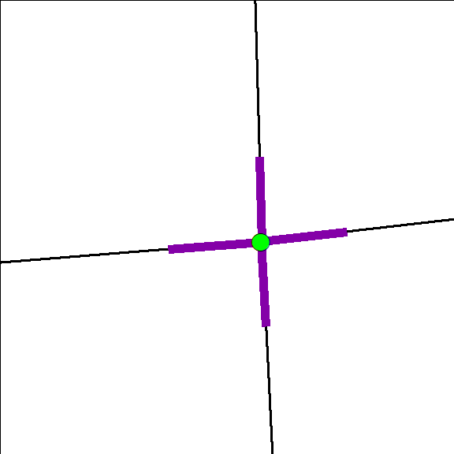
ArcMap AddIns
UpdateAll Button
Before Road
Centerline
Edits
After Road
Centerline
Edits
After
Running
UpdateAll
(attributes
too!)
Notes:
Here we have a view of a few intersections in Vermont’s capital city, Montpelier

Slide 38
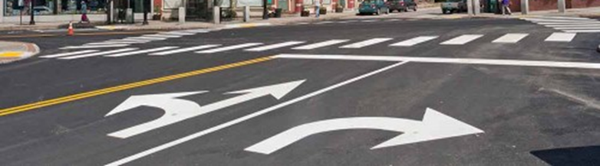
Future Directions
Complex (or all!) Intersections in Tables
    Geometry of Intersections (points) and Approaches (lines) = geometry of Principal Nodes and Principal NodeLegs
    Attributes represent the entire intersection or approach direction
(Nodes and NodeLegs datasets reserved for feature-specific attributes)

Slide 39
Future Directions
Maintain rules for summarizing Intersections (and complex approaches) within Table attributes
    Add AADT of dual carriageways
    Average Leg skew angles
    represent the entire intersection or approach direction

Slide 40
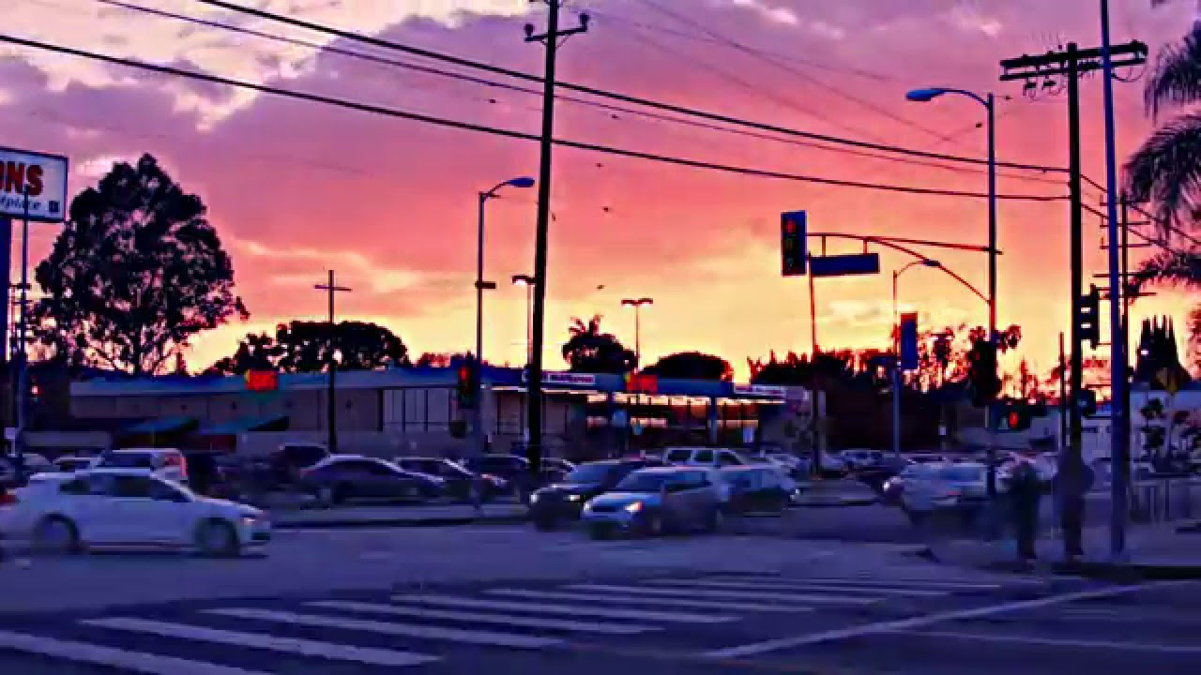
Thanks! Questions?
VTrans Mapping Unit:
  Johnathan Croft
  Sara Moulton
  Michael Trunzo
Contact:
Kerry.Alley@vermont.gov

