Slide 1
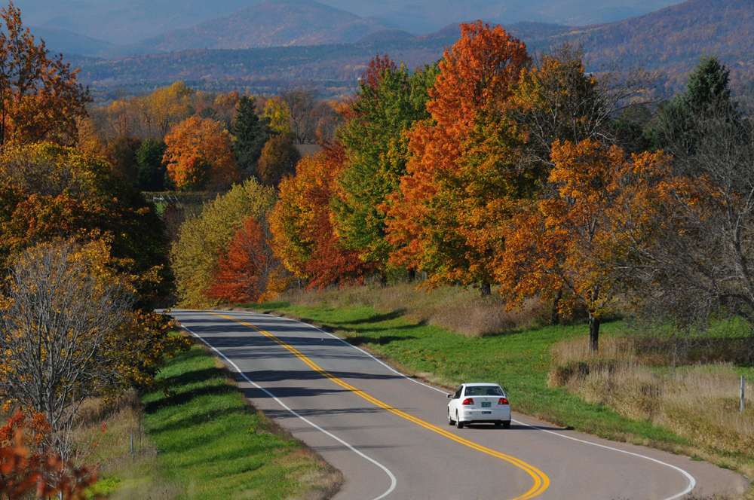
Creating Curve Data on Local Roads to Support
Safety Analysis
Vermont Agency of Transportation

Slide 2
VTrans has curve data for all of our state highways, but not for any local roads which make up over 80% of Vermont’s highways.
We need this data to support crash analysis, but it would be too expensive to collect the data in the field through traditional methods.
Works Consulting provides a better solution: generate curve data directly from the road centerline geometry.

Slide 3
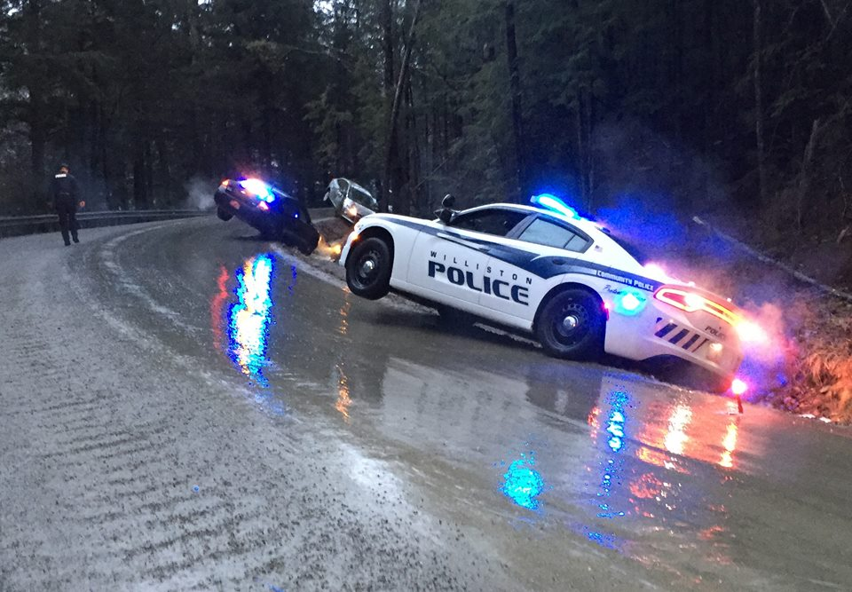
Rural roads are the deadliest roads.
Dugway Rd. Richmond, VT March 2016

Slide 4
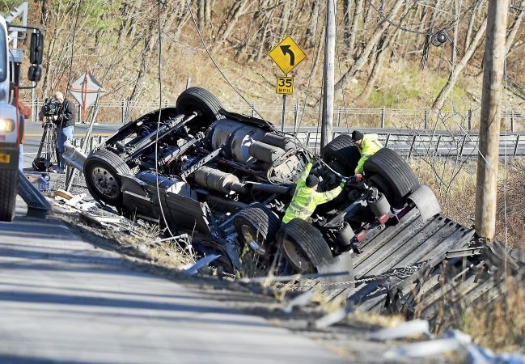
The majority of highway fatalities occur on rural roads.
In 2014, 19% of the U.S. population lived in rural areas, but rural fatalities accounted for 51% of fatal crashes.

Slide 5
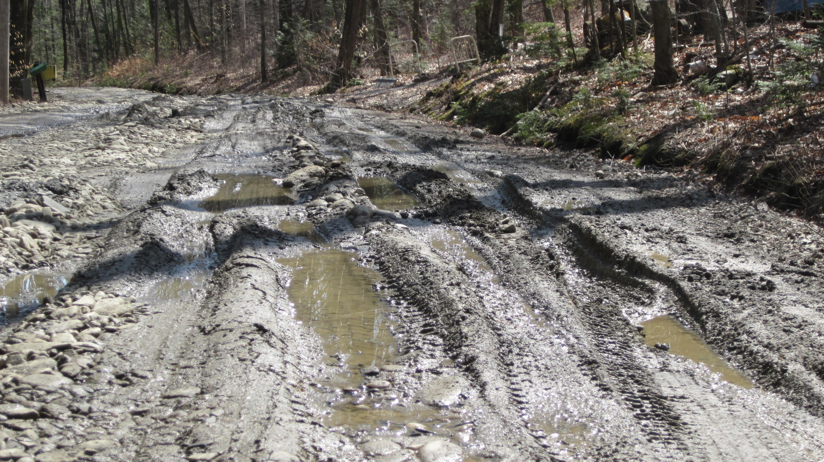
Mud Season
In not necessarily the most ideal conditions….

Slide 6
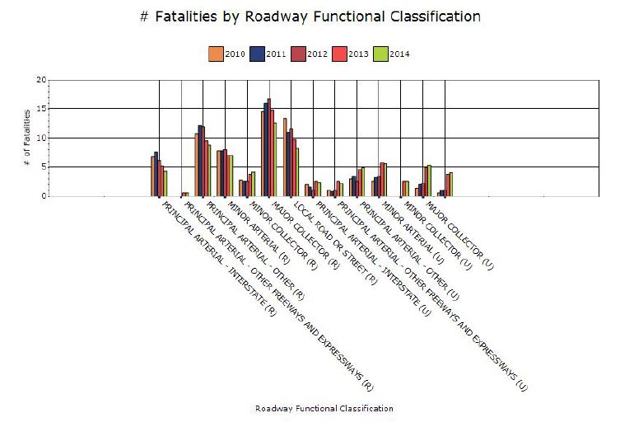
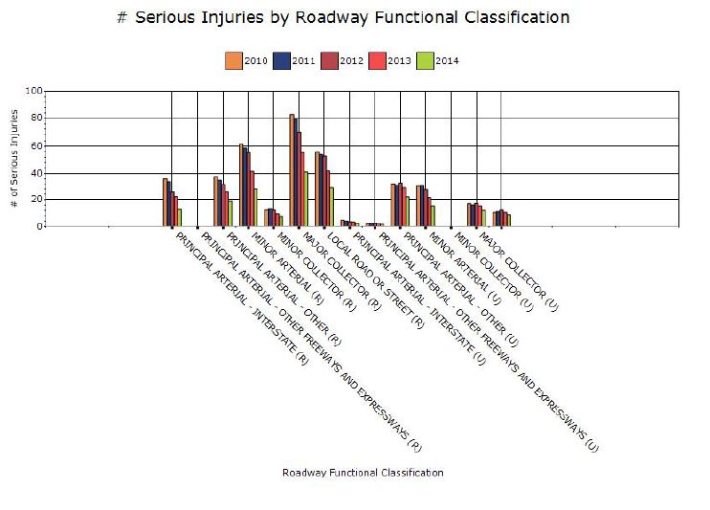

Slide 7
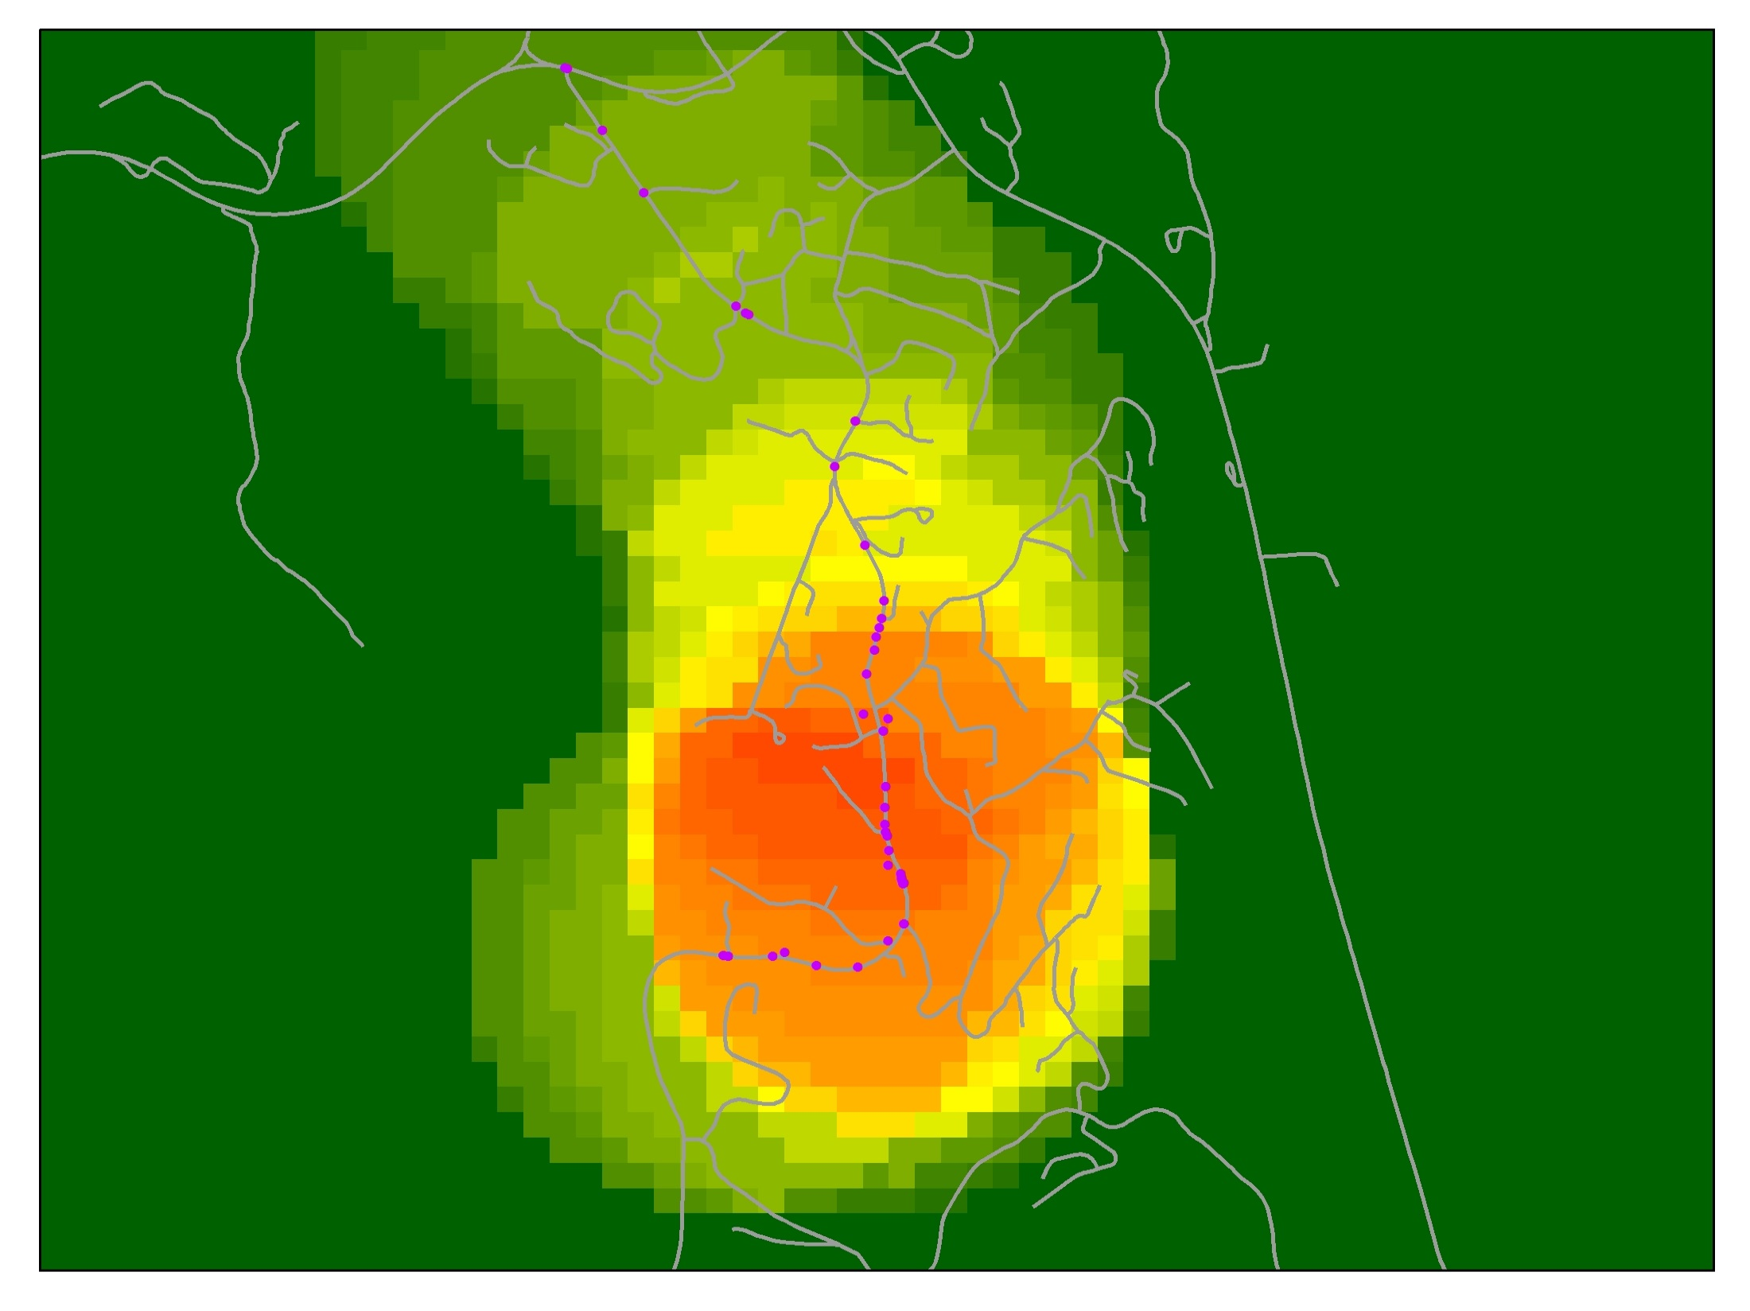
By analyzing curves combined with crash data, we can identify locations in need of safety improvements.

Slide 8
So how to generate curve data for the rural local roads in a cost effective manner, and with good accuracy and reliability to feed the analytical tools?
Works Consulting is providing the solution for the creation of the curve data through processing of the road centerline geometry. Joe Breyer can provide some insight to the process and how this is done.

Slide 9
Here is a space for Joe’s slides to start

Slide 10
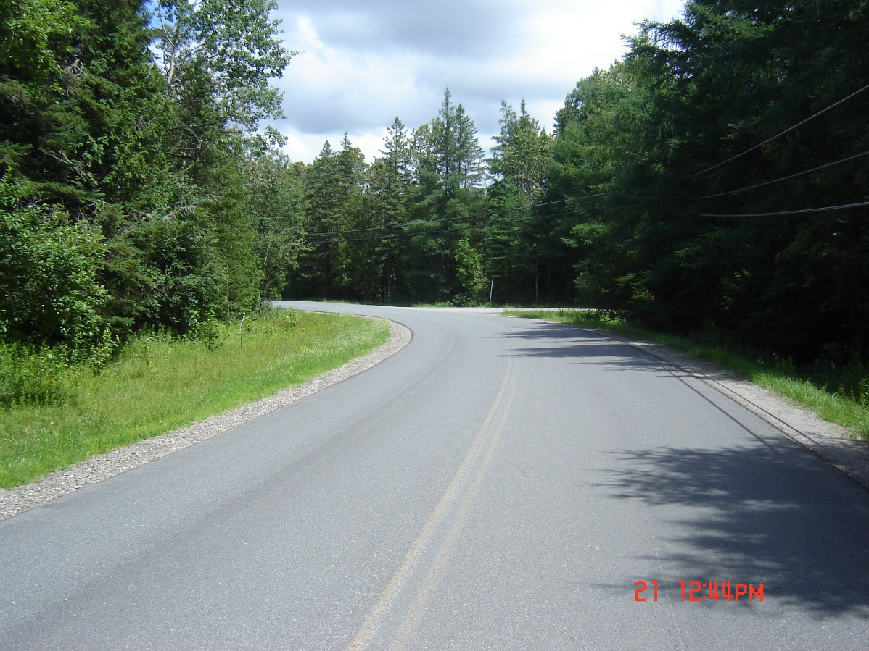
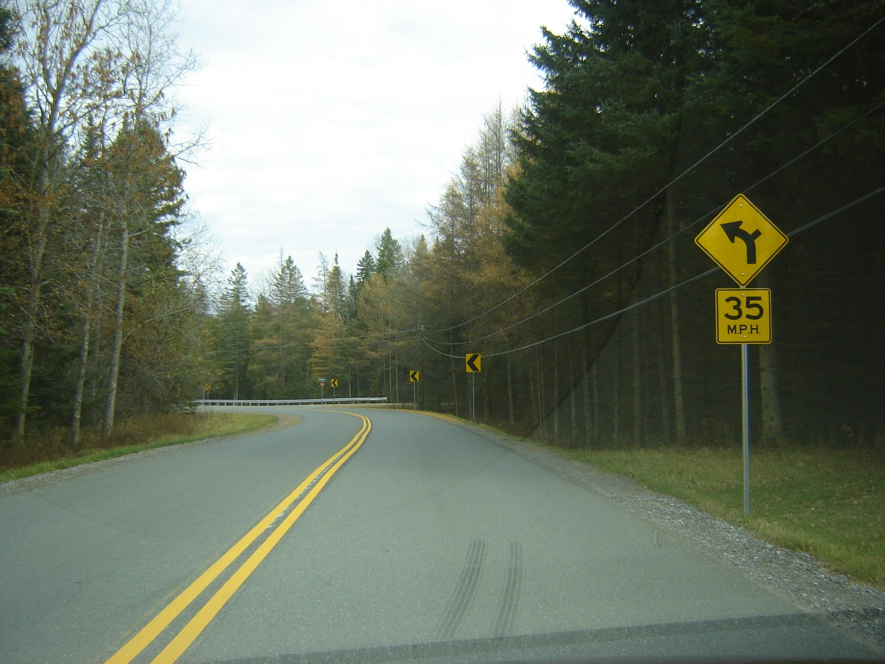
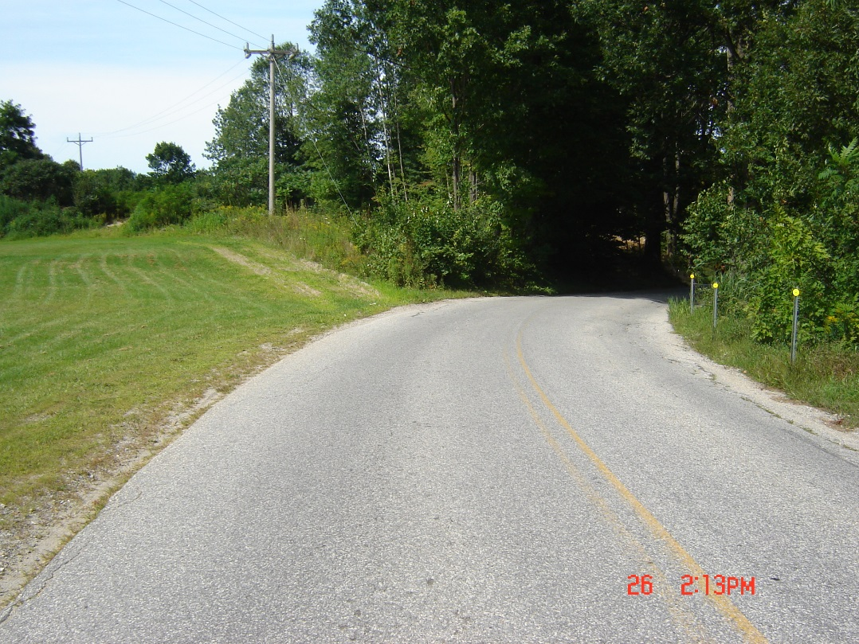
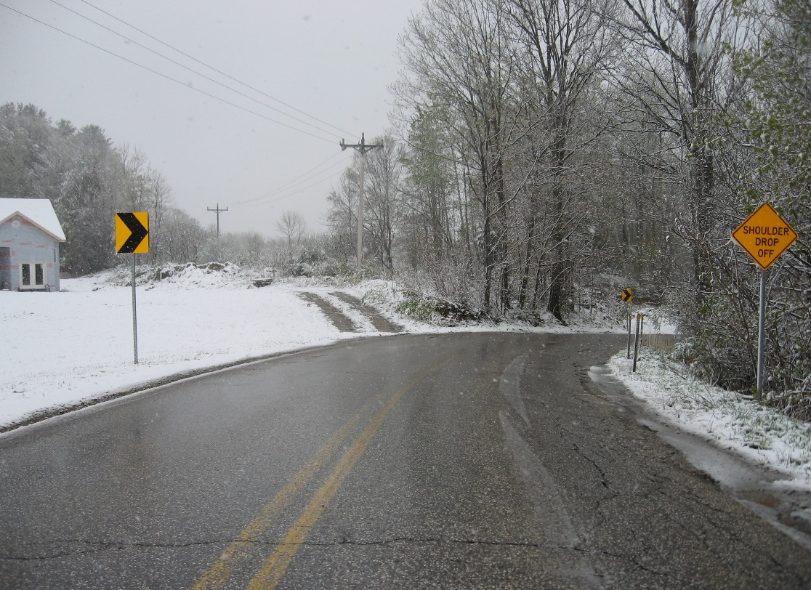

Slide 11
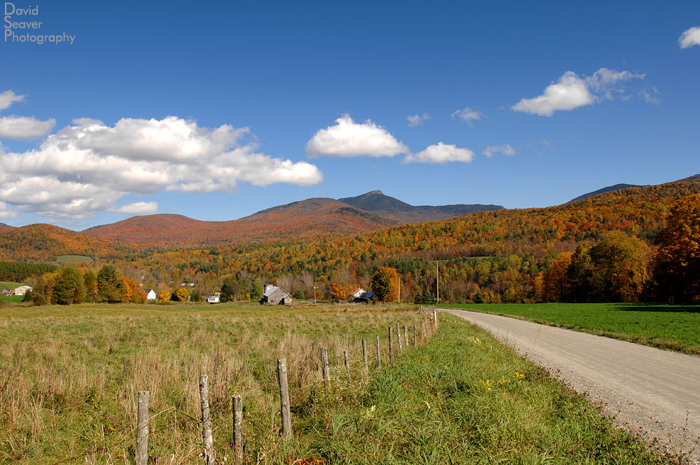
Questions?
Michael Trunzo
Vermont Agency of Transportation
michael.trunzo@vermont.gov
802-828-3974

