Slide 1
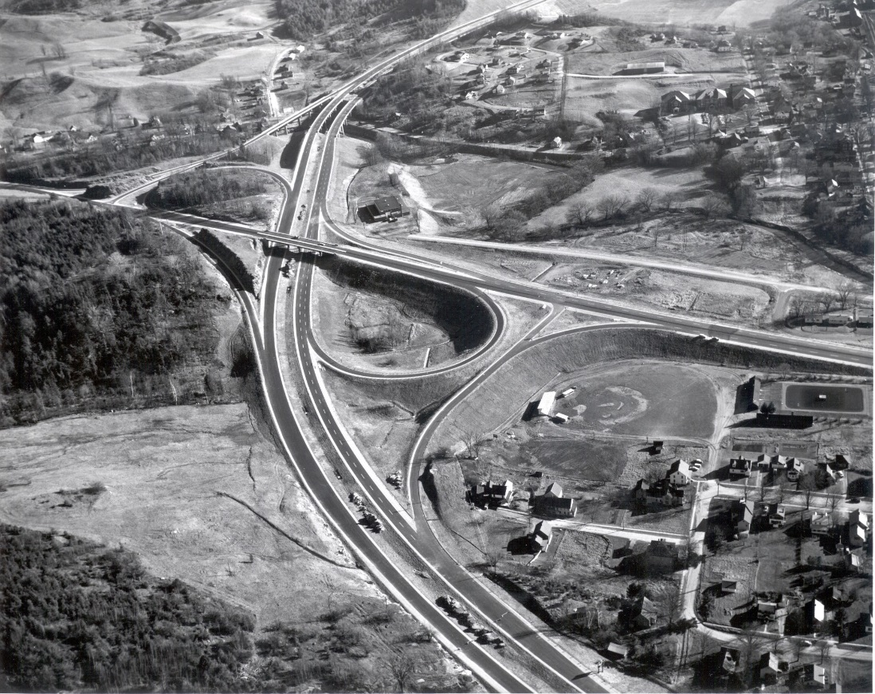

Functional Classification
An Overview and Evaluation
Vermont Agency of Transportation
Mapping Section

Slide 2
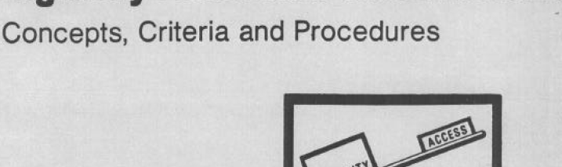
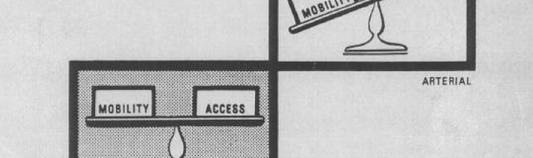

Basics of Functional Classification
Functional classification provides a hierarchy to assigning categories to highways based on how they operate as part of the network.
This classification system is defined by the Federal Highway Administration (FHWA) and has been in use since the early 1990’s.
https://www.fhwa.dot.gov/planning/processes/statewide/related/highway_functional_classifications/fcauab.pdf

Slide 3
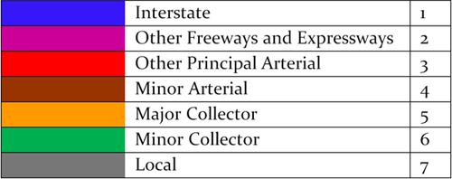
Functional Classification – The Classes
Three main types of highway based on their function; arterials with few access points and high mobility, to collectors that feed traffic to arterials from locals and have a mix of access and mobility characteristics, to locals with high access and that represent the largest mileage of highways in the network.
https://www.fhwa.dot.gov/planning/processes/statewide/related/highway_functional_classifications/fcauab.pdf

Slide 4
Assignment of Classes and Criteria
Classification is defined using a series of criteria based on accessibility, mobility and other key factors.
This is well defined in the field manual.

Slide 5
Functional Class Mileage
1 - Principal Arterial Interstate : 378.29 Miles
2 - Principal Arterial Freeways : 23.88 Miles
3 - Principal Arterial : 469.831Miles
4 - Minor Arterial : 886.632 Miles
5 - Major Collector : 2221.516 Miles
6 - Minor Collector Urban : 32.129 Miles
6 - Minor Collector Rural : 903.117 Miles
7 - Local Road : 9259.539 Miles
ftp://vtransmaps.vermont.gov/Maps/Publications/Maps/FederalAidStateMaps/FederalAidHighwaysMap_2015.pdf

Slide 6
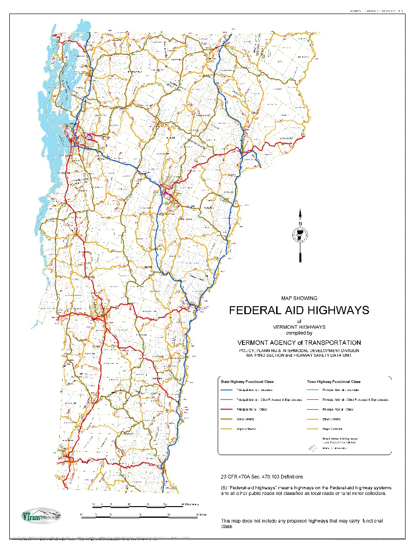
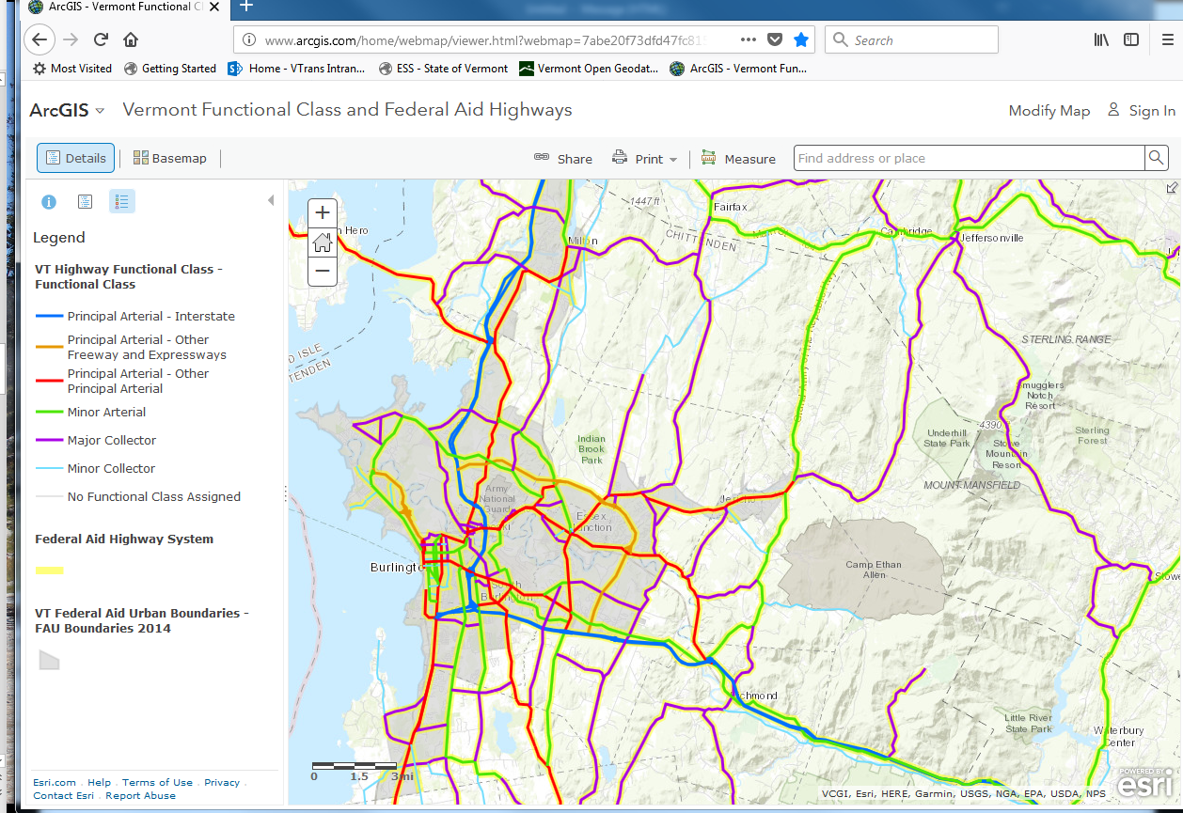
Federal Aid System
Functional Classification provides a means of defining the Federal Aid System for highways, which are all principal and minor arterials, major collectors, and urban minor collectors.
http://www.arcgis.com/home/webmap/viewer.html?webmap=7abe20f73dfd47fc8155f2a111f5368a
ftp://vtransmaps.vermont.gov/Maps/Publications/Maps/FederalAidStateMaps/FederalAidHighwaysMap_2015.pdf

Slide 7
Decennial Census and FAU Boundaries
Every 10 years, following the decennial census, the federal area urban boundaries are assessed and modified based on current population patterns.
This process is done through VTrans in consultation and coordination with the RPCs and the MPO.
The latest boundaries were completed in 2014.

Slide 8
Functional Class Changes
The functional class changed the classification schema from 13 to 7 categories, removing the urban and rural designation. In doing this, we need to evaluate whether some classifications still make sense.
The changes in urban area boundaries may lead to the evaluation and possible changes to the functional class.

Slide 9
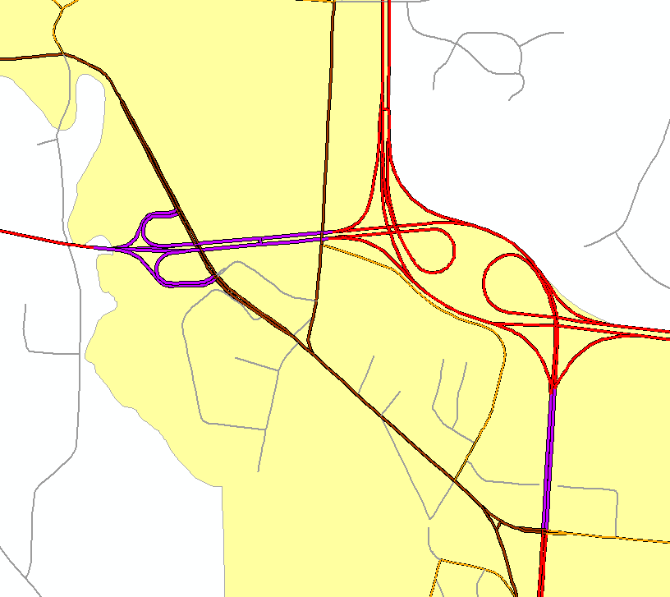
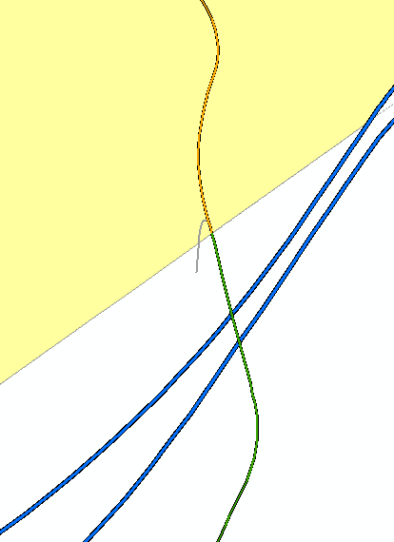
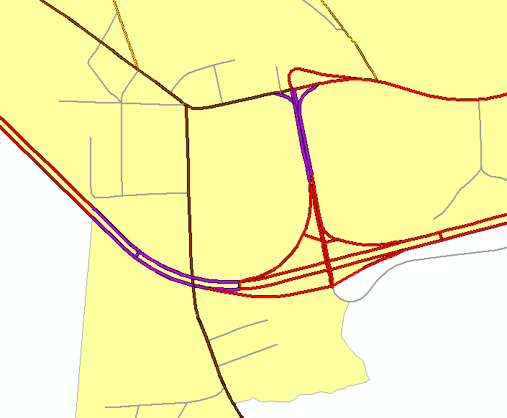
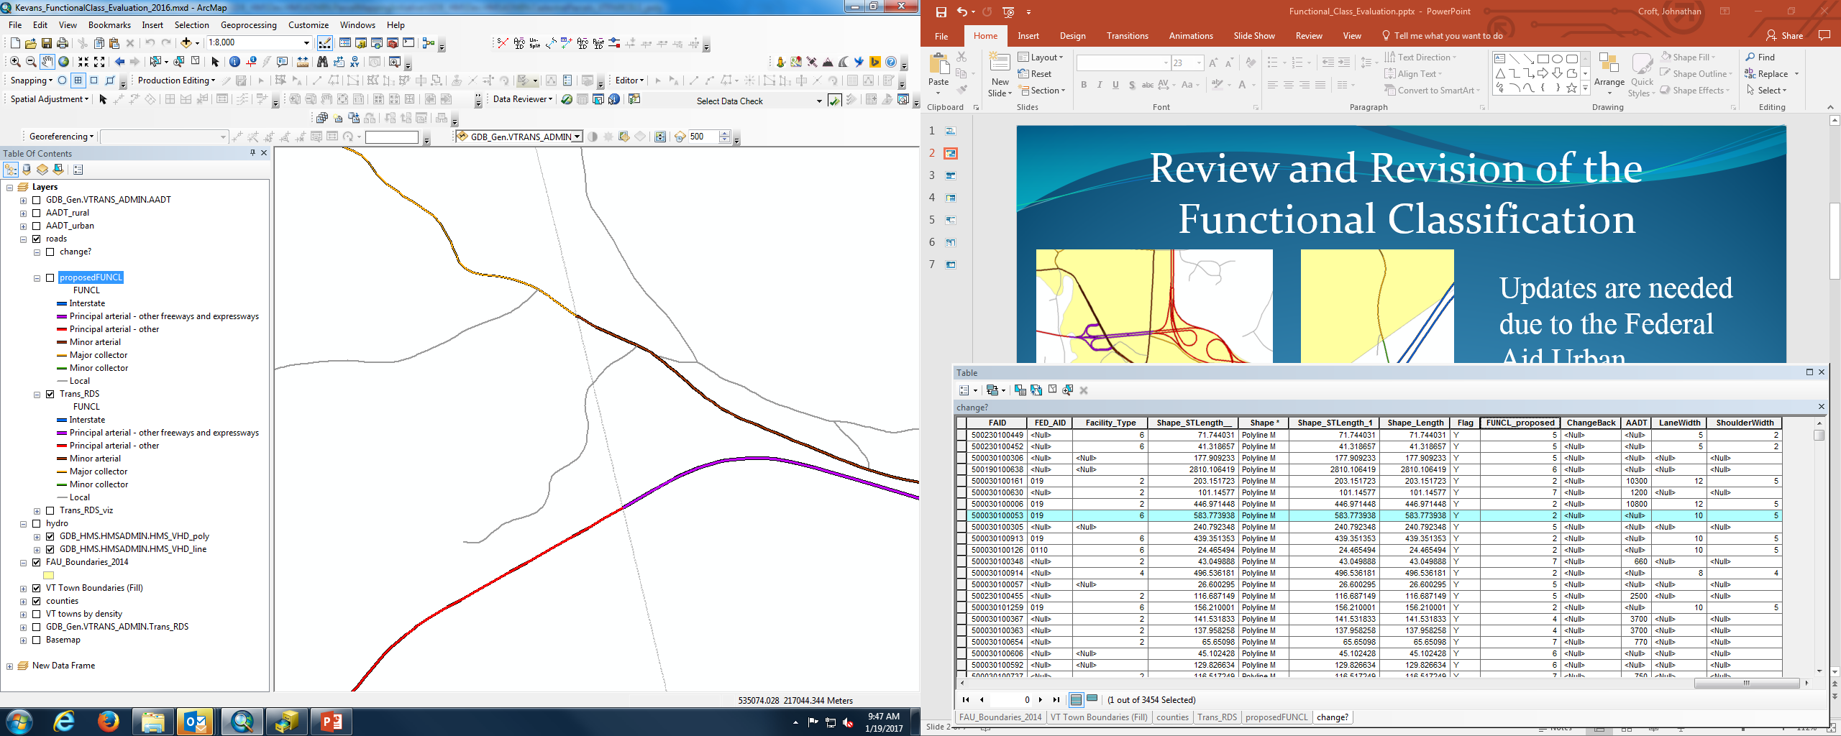
Examples of Functional Class and the FAU
Updates are needed due to the Federal Aid Urban Boundaries that were changed following the 2010 Census.
Many routes have not been assessed since they were initially established.

Slide 10
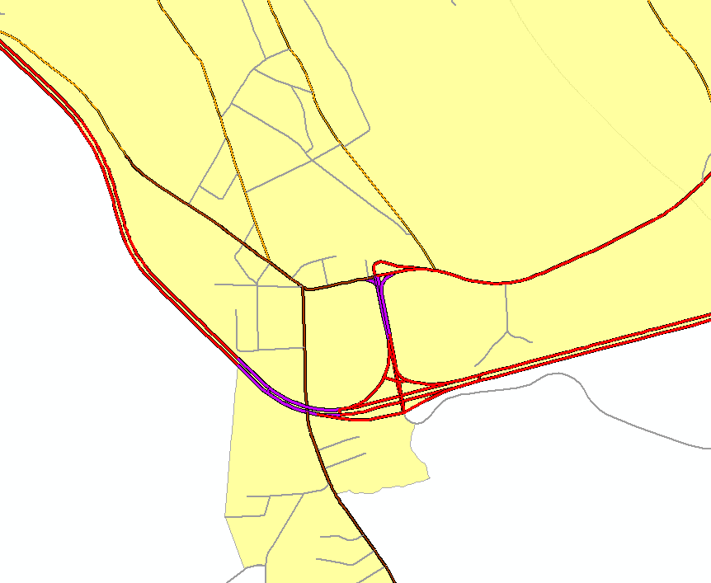
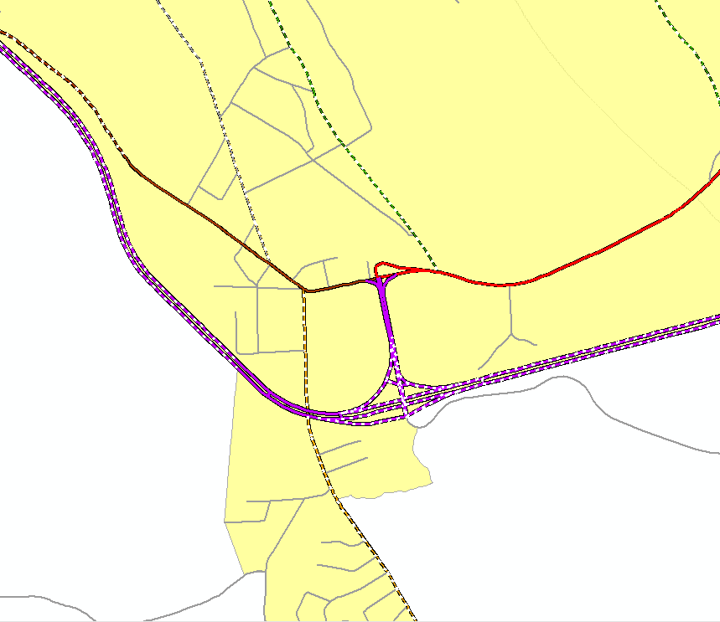
Coarse Screen of the Highways
A Coarse Screen of the Highways was performed to assess the classification and what a potential functional classification could be, based on the FHWA. From these sections, a select set were identified for assessment of possible change in functional class.
These sections needs additional review based on an understanding of local conditions.
https://www.fhwa.dot.gov/planning/processes/statewide/related/highway_functional_classifications/fcauab.pdf

Slide 11
Next Steps - 4.1.10 Review of Functional Classification System
In 2014 the RPCs assisted VTrans with reviewing and adjusting Urban Area Boundaries. During that exercise, and as a result of changes in the urban area boundaries it became evident that there were some inconsistencies in the Functional Classification for some Vermont roadways. Changes in the functional class coding during this period also contributed to the inconsistencies. Following up on the 2014 effort, VTrans would like to enlist the RPCs assistance in reviewing and seeking regional input on proposed changes in the Functional Classification system.
The purpose of the functional classification system is to identify the particular role a roadway plays in moving vehicles through a network of highways. It groups roads into three main functional classes as defined by the United States Federal Highway Administration: arterial, collector, and local.
In the winter of 2017 VTrans will perform a review of the current functional classification system and provide each RPC with a listing of proposed changes. Each RPC will be asked to review the list and discuss any significant changes with regional and local officials and provide feedback to VTrans. It is anticipated that there may be a need for some RPCs to reach out and receive input from a small subset of affected municipalities. However, a comprehensive outreach effort (similar to that undertaken by Chittenden County RPC in 2017) is not anticipated. Any proposed changes will need to conform with the FHWA guidance document “The Highway Functional Classification: Concepts, Criteria and Procedures, 2013 Edition”.
https://www.fhwa.dot.gov/planning/processes/statewide/related/highway_functional_classifications/fcauab.pdf
Timeline & Deliverables
10/2/2017 - VTrans begins review of the functional class and starts to prepare listing of any inconsistencies
1/5/2018 – VTrans provides listing to each RPC on suggested functional class changes
6/1/2018 - RPCs provide feedback to VTrans on the changes and any concurrence or comments regarding the changes
8/3/2018 - RPCs and VTrans finalize listing of functional class changes
8/10/2018 - VTrans prepares and submits functional class changes for FHWA review and approval
Questions: Johnathan Croft, VTrans GIS Administrator at Johnathan.Croft@vermont.gov

Slide 12
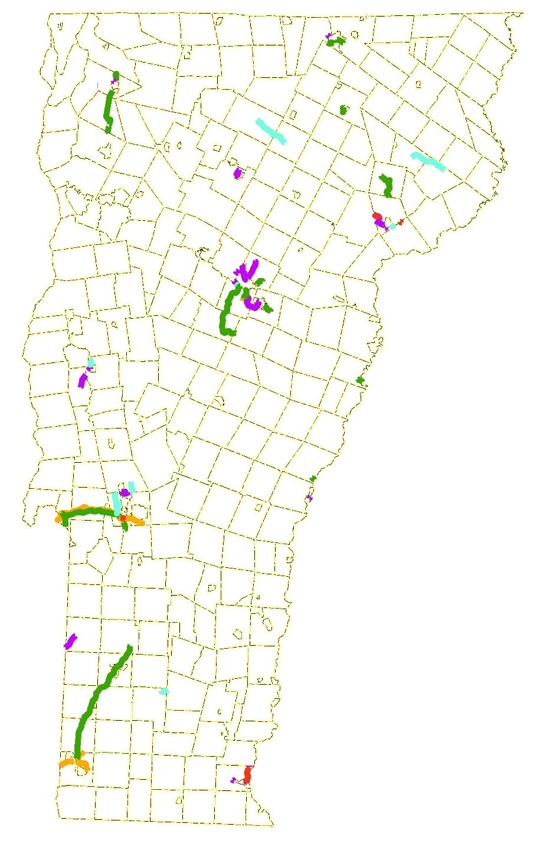
Highway Segments for Review
The highway segments for review have been posted to two data layers in a File GDB, one that includes all the arcs with AADT, widths, shoulder widths, etc, and one that has the arcs aggregated by possible functional class change. The later includes RPC initials.
This data have been posted to FTP. VTrans needs to perform an internal review on the proposed changes, while the RPCs review the proposed changes. Any modifications from the internal review will be shared with the RPCs.
Are these the only proposed changes? No, if there are other segments that meet the FHWA criteria they can be added to the proposed list.
ftp://vtransmaps.vermont.gov/Maps/DataDistribution/Functional_Class_Review_2018/FunctionalClass_Evaluation_2018.gdb.zip

Slide 13
Questions???
Johnathan Croft
Johnathan.Croft@vermont.gov
(802) 828-2600
Sara Moulton
Sara.Moulton@vermont.gov
(802) 828-2109
Michael Trunzo
Michael.Trunzo@vermont.gov
(802) 828-3974
Kerry Alley
Kerry.Alley@vermont.gov
(802) 828-3666
Kevan Grimaldi
Kevan.Grimaldi@vermont.gov
(802) 828-5363
VT Agency of Transportation
Policy, Planning & Intermodal
Development Division -
Mapping Section
Notes:
I would be glad to answer any questions regarding our projects and you can also reach out to the full team, listed here for details.
Questions???

